Slide 2
RANK | MUNICIPALITY | E-OPT COVERAGE
1 | CITY OF CATBALOGAN, Samar | 98.88%
2 | BIRI, N. Samar | 89.79%
3 | PARANAS, Samar | 85.58%
4 | TALALORA, Samar | 85.22%
5 | NAVAL, Biliran | 82.26%
6 | TANAUAN, Leyte | 81.93%
7 | BURAUEN, Leyte | 80.95%
8 | SAN JOSE DE BUAN, Samar | 80.42%
9 | CAIBIRAN, Biliran | 80.08%
10 | CITY OF CALBAYOG, Samar | 80.01%
LGUs with > 80% Coverage:
Only 10 LGUs managed to reach an >80 % coverage in OPT Plus

Slide 3
SYMBOLS GUIDE
↓
Decreasing Trend
↑
Increasing Trend
↓
↓
Double Arrows, > 2% decrease or increase in prevalence compared to 2021 prevalence

Slide 4
2022 OPERATION TIMBANG PLUS COVERAGE
Local Government Units | No. of LGUs | No. of LGU with Submission | % Submission
Province | 6 | 6 | 100%
City | 7 | 7 | 100%
Municipality | 141 | 141 | 100%
Total Population | Estimated population 0-59 months | Actual number of 0-59 | Percent Coverage
4,865,157 | 550,559 | 355,004 | 64.5 % ↓
No. of IP PS measured

Slide 5
Province/Independent City | Total Number of Cities/Municipalities | Number of Cities/Municipalities with OPT Plus Results | Total Number of Barangays | Number of Barangays with OPT Results
(1) | (2) | (3) | (4) | (5)
EASTERN SAMAR | 23 | 23 | 597 | 587
SAMAR | 26 | 26 | 951 | 923
NORTHERN SAMAR | 24 | 24 | 569 | 549
LEYTE | 41 | 41 | 1,394 | 1,353
SOUTHERN LEYTE | 19 | 19 | 500 | 500
BILIRAN | 8 | 8 | 132 | 132
TACLOBAN | 0 | 0 | 138 | 138
ORMOC | 0 | 0 | 110 | 110
BAYBAY* | 0 | 0 | 92 | 92
MAASIN* | 0 | 0 | 70 | 70
CATBALOGAN* | 0 | 0 | 57 | 57
CALBAYOG* | 0 | 0 | 157 | 132
BORONGAN* | 0 | 0 | 61 | 61
*Component Cities

Slide 6
STATUS
(0-59 months Preschool Children)
WEIGHT FOR AGE | Magnitude | Prevalence
Underweight | 18, 952 | 5.34 % ↓
Severely Underweight | 4, 752 | 1.34% ↓
UW + SUW | 23,704 | 6.68 %
HEIGHT/LENGTH FOR AGE
Moderately Stunted | 37, 919 | 10.69 % ↓
Severely Stunted | 14, 608 | 4.12%↓
MS+SS | 52, 527 | 14.81 %
WEIGHT FOR LENGTH/HEIGHT
Normal | 325, 377 | 91.79 % ↓
Moderately Wasted | 8, 416 | 2.37% ↓
Severely Wasted | 3,175 | 0.90% ↓
Overweight | 10, 146 | 2.86% ↓
Obese | 7, 383 | 2.08% ↓
MW+SW | 14, 862 | 3.27 %
OW+Ob | 20, 690 | 4.94 %

Slide 7
MALNOURISHED 0-59 MONTHS OLD CHILDREN IN REGION 8 FOR 2022
4 out of 50 children are Underweight
2 out of 50 children are Wasted

Slide 8
3 out of 20 children are Stunted
1 out of 20 children is Overweight/Obese

Slide 9
2022 REGIONAL NUTRITIONAL STATUS
(per age group)
Underweight and Stunting Prevalence increases as age of child increases
Wasting and Overnutrition Prevalence decreases as age of child increases
6-11
12-23

Slide 10
NUTRITIONAL STATUS
(0-59 months Preschool Children)
5-YEAR COMPARATIVE TREND
Overall decreasing trend of malnutrition

Slide 11
MODERATELY and SEVERELY UNDERWEIGHT
Child’s weight is lower or below the
normal weight for his/her age
Underweight <-2SD Severely Underweight <-3SD
WHO Cut Off values, 1995
<10% low prevalence
10-19% medium prevalence
20-29% high prevalence
≥ 30% Very high prevalence

Slide 12
BENCHMARK FOR NUTRITION STATUS (based on 8th National Nutrition Survey)
UNDERWEIGHT
≥ 30% (Very High)
20-29 % (High)
10-19% (Medium)
< 10% (Low)

Slide 13
WEIGHT FOR AGE
PREVALENCE OF UNDERWEIGHT+SEVERELY UNDERWEIGHT
PROVINCIAL & INDEPENDENT CITIES RANKING
RANK | PROVINCE & INDEPENDENT CITIES | MAGNITUDE | PREVALENCE
1 | Samar | 5,157 | 7.05% ↓
2 | Leyte | 7,765 | 6.99% ↓
3 | Biliran | 1,073 | 6.90% ↑
4 | Northern Samar | 3,563 | 6.84% ↓↓
5 | Eastern Samar | 2,467 | 6.84%↑
6 | Ormoc City | 1,240 | 5.83 %↓
7 | Southern Leyte | 1,405 | 5.25%↓
8 | Tacloban City | 1,034 | 5.15%↓↓

Slide 14
WEIGHT FOR AGE
PREVALENCE OF UNDERWEIGHT+ SEVERELY UNDERWEIGHT
5-YEAR COMPARATIVE TREND BY PROVINCE & INDEPENDENT CITIES

Slide 15
WEIGHT FOR AGE
PREVALENCE OF UNDERWEIGHT +SEVERELY UNDERWEIGHT
Ranking per Component City
RANK | CITY | MAGNITUDE | PREVALENCE
1 | Borongan | 407 | 9.18%↓
2 | Baybay | 614 | 7.21%↓
3 | Calbayog | 830 | 4.36%↓
4 | Maasin | 156 | 2.97%↑
5 | Catbalogan | 312 | 2.35%↓↓

Slide 16
WEIGHT FOR AGE
PREVALENCE OF UNDERWEIGHT + SEVERELY UNDERWEIGHT
5-YEAR COMPARATIVE TREND BY COMPONENT CITY

Slide 17
WEIGHT FOR AGE
PREVALENCE OF UNDERWEIGHT +SEVERELY UNDERWEIGHT
Top 10 LGUs
PROVINCE | NAME OF LGU | COVERAGE | PREVALENCE
Samar | MATUGUINAO | 75.77% | 21.32%
Samar | HINABANGAN | 64.24% | 19.17%
E.Samar | MASLOG | 77.16% | 16.20%
Samar | TAGAPUL-AN | 48.26% | 14.58%
Samar | SAN JOSE DE BUAN | 80.42% | 14.34%
Samar | ALMAGRO | 49.65% | 13.91%
E.Samar | JIPAPAD | 70.53% | 13.65%
Leyte | JULITA | 61.10% | 13.58%
Samar | VILLAREAL | 61.08% | 13.22%
Leyte | ABUYOG | 51.99% | 13.18%

Slide 18
MODERATE and SEVERE STUNTING
Child’s height is lower or below the normal height for his/her age
Moderately Short/stunted <-2SD Severely Stunted <-3SD
Cut-off values, de Onis et al., 2018
<2.5% very low
2.5 to <10% low
10 to <20% medium
20 to <30% high
≥30% very high

Slide 19
BENCHMARK FOR NUTRITION STATUS (based on 8th National Nutrition Survey)
STUNTING
≥ 40% (Very High)
30-39 % (High)
20-29% (Medium)
< 20% (Low)

Slide 20
HEIGHT FOR AGE
PREVALENCE OF MODERATELY+SEVERELY STUNTED
Provincial & INDEPENDENT CITIES Ranking
RANK | PROVINCE | MAGNITUDE | PREVALENCE
1 | Samar | 12,199 | 16.67%↓↓
2 | Eastern Samar | 5,575 | 15.46%↑
3 | Northern Samar | 7,862 | 15.10%↓↓
4 | Leyte | 16,647 | 14.99%↓↓
5 | Biliran | 2,043 | 13.13%↑
6 | Ormoc City | 2,784 | 13.09%↓
7 | Southern Leyte | 3,133 | 11.71%↓
8 | Tacloban City | 2, 284 | 11.37%↓↓

Slide 21
HEIGHT FOR AGE
PREVALENCE OF MODERATELY+SEVERELY STUNTED
5-YEAR COMPARATIVE TREND BY PROVINCE & INDEPENDENT CITIES

Slide 22
HEIGHT FOR AGE
PREVALENCE OF MODERATELY+SEVERELY STUNTED
Ranking per COMPONENT City
RANK | CITY | MAGNITUDE | PREVALENCE
1 | Borongan | 970 | 21.88%↓
2 | Baybay | 1,070 | 12.56%↓↓
3 | Calbayog | 2,215 | 11.64%↓↓
4 | Catbalogan | 1,027 | 7.73%↓↓
5 | Maasin | 279 | 5.31%↓

Slide 23
HEIGHT FOR AGE
PREVALENCE OF MODERATELY+SEVERELY STUNTED
COMPONENT City Ranking
5-YEAR COMPARATIVE TREND

Slide 24
HEIGHT FOR AGE
PREVALENCE OF MODERATELY+SEVERELY STUNTED
Top 10 LGUs
PROVINCE | NAME OF LGU | COVERAGE | PREVALENCE
Samar | HINABANGAN | 64.24% | 41.25%
Samar | MATUGUINAO | 75.77% | 40.39%
Samar | SAN SEBASTIAN | 58.20% | 35.58%
E. Samar | MERCEDES | 37.08% | 34.48%
Samar | SAN JOSE DE BUAN | 80.42% | 31.03%
Samar | SANTA MARGARITA | 61.89% | 28.75%
N. Samar | LOPE DE VEGA | 64.41% | 27.90%
Samar | VILLAREAL | 61.08% | 27.87%
Leyte | ALANGALANG | 58.27% | 27.43%
E. Samar | MASLOG | 77.16% | 26.44%

Slide 25
MODERATE and SEVERE WASTING
Child’s body weight in proportion to length/height or thinness is low relative to the standard weight-for-length/height
Moderately Wasted <-2SD Severely Wasted <-3SD
Cut of Values, de Onis et al, 2018
<2.5% very low
2.5 to <5% low
5 to <10% medium
10 to <15% high
≥ 15% very high

Slide 26
BENCHMARK FOR NUTRITION STATUS (based on 8th National Nutrition Survey)
WASTING
≥ 15 % (Critical)
10-14 % (Serious)
5-9 % (Poor)
< 5% (Acceptable)

Slide 27
WEIGHT FOR LENGTH/HEIGHT
PREVALENCE OF MODERATELY+SEVERELY WASTED
Provincial & INDEPENDENT CITIES Ranking
RANK | PROVINCE | MAGNITUDE | PREVALENCE
1 | Biliran | 731 | 4.70%↑
2 | Leyte | 4,573 | 4.12%↓
3 | Ormoc City | 801 | 3.78%↓
4 | Tacloban City | 671 | 3.34%↓↓
5 | Eastern Samar | 1,197 | 3.32%↓
6 | Northern Samar | 1,536 | 2.95%↓
7 | Southern Leyte | 725 | 2.71%↓
8 | Samar | 1,357 | 1.85%↓↓

Slide 28
MODERATELY + SEVERELY WASTED
(WEIGHT FOR LENGTH/HEIGHT)
5-YEAR COMPARATIVE TREND BY PROVINCE & INDEPENDENT CITIES

Slide 29
WEIGHT FOR LENGTH/HEIGHT
PREVALENCE OF MODERATELY +SEVERELY WASTED
Ranking per COMPONENT City
RANK | CITY | MAGNITUDE | PREVALENCE
1 | Borongan | 244 | 5.50%↓↓
2 | Calbayog | 373 | 1.96%↓
3 | Baybay | 136 | 1.60%↓
4 | Maasin | 38 | 0.72%↑
5 | Catbalogan | 55 | 0.41%↓↓

Slide 30
WEIGHT FOR LENGTH/HEIGHT
PREVALENCE OF MODERATELY+SEVERELY WASTED
Ranking per City
5-YEAR COMPARATIVE TREND

Slide 31
WEIGHT FOR LENGTH/HEIGHT
PREVALENCE OF MODERATELY+SEVERELY WASTED
Top 10 LGUs
PROVINCE | NAME OF LGU | COVERAGE | PREVALENCE
Leyte | CARIGARA | 51.58% | 9.96%
Leyte | MATAG-OB | 39.24% | 9.22%
S. Leyte | Silago | 66.35% | 8.60%
Biliran | CAIBIRAN | 80.08% | 8.49%
N. Samar | SILVINO LOBOS | 69.04% | 8.23%
Biliran | BILIRAN | 76.83% | 8.02%
Leyte | ALANGALANG | 58.27% | 7.71%
Leyte | ISABEL | 56.10% | 7.69%
Leyte | PALOMPON | 47.04% | 7.65%
Leyte | ABUYOG | 51.99% | 7.31%

Slide 32
OVERWEIGHT and OBESITY
Child’s body weight in proportion to length/height or fatness is high relative to the standard weight for his/her weight-for-length/height
Overweight >+2SD Obese >+3SD
Cut of Values, de Onis et al, 2018
<2.5% very low
2.5 to <5% low
5 to <10% medium
10 to <15% high
≥ 15% very high

Slide 33
WEIGHT FOR LENGTH/HEIGHT
PREVALENCE OF OVERWEIGHT +OBESITY
Provincial & INDEPENDENT CITIES Ranking
RANK | PROVINCE | MAGNITUDE | PREVALENCE
1 | Tacloban City | 1, 319 | 6.57% ↓
2 | Eastern Samar | 2, 116 | 5.87%↓
3 | Southern Leyte | 1, 519 | 5.68%↓
4 | Leyte | 5,805 | 5.23%↓
5 | Ormoc City | 931 | 4.38% ↑
6 | Northern Samar | 2,242 | 4.31% ↓
7 | Biliran | 645 | 4.14% ↑
8 | Samar | 2,952 | 4.03%↓

Slide 34
OVERWEIGHT + OBESE (WEIGHT FOR LENGTH/HEIGHT)
5-YEAR COMPARATIVE TREND BY PROVINCE & INDEPENDENT CITIES

Slide 35
WEIGHT FOR LENGTH/HEIGHT
PREVALENCE OF PREVALENCE OF OVERWEIGHT +OBESITY Ranking per City
RANK | CITY | MAGNITUDE | PREVALENCE
1 | Borongan | 430 | 9.70%↓↓
2 | Calbayog | 859 | 4.51%↑
3 | Baybay | 227 | 2.66%↓
4 | Catbalogan | 304 | 2.29%↓↓
5 | Maasin | 118 | 2.25%↑

Slide 36
WEIGHT FOR LENGTH/HEIGHT
PREVALENCE OF PREVALENCE OF OVERWEIGHT +OBESITY
Ranking per City
5-YEAR COMPARATIVE TREND

Slide 37
WEIGHT FOR LENGTH/HEIGHT
PREVALENCE OF PREVALENCE OF OVERWEIGHT +OBESITY
Top 10 LGUs
PROVINCE | NAME OF LGU | COVERAGE | PREVALENCE
E. Samar | MERCEDES | 37.08% | 14.83%
S. Leyte | Malitbog | 45.41% | 12.23%
Leyte | PALOMPON | 47.04% | 11.41%
Samar. | HINABANGAN | 64.24% | 10.47%
N. Samar | SAN VICENTE | 33.99% | 10.22%
S. Leyte | San Ricardo | 41.97% | 9.83%
E. Samar | CITY OF BORONGAN | 49.60% | 9.70%
S. Leyte | Tomas Oppus | 58.25% | 9.38%
E. Samar | HERNANI | 49.46% | 9.32%
Samar. | BASEY | 51.49% | 9.15%

Slide 38
SUMMARY
OPT+ Coverage in 2022 is lower than the 2021 OPT+
Decreasing trend on malnutrition in Samar, N. Samar, Leyte, and S. Leyte, and Tacloban City
Increased prevalence of all forms of malnutrition in Biliran province
Increased prevalence of UW and ST in E. Samar
Increased prevalence of Overnutrition in Ormoc City
Among component cities, Borongan remains top in all indicators but decreasing in trend
Stunting manifests on 12 months and steadily increase until 59 months

Slide 39
Improved Regional Nutritional Status
Increased technical assistance from government and private institutions
Supportive LCEs due to intensive advocacy
OPT DQC rolled out in pilot LGUs
Full-time Designated M/C/PNAOs
Organization and activation of Local Nutrition Committees (LNCs)
Increased investments in Nutrition at the local level
GOOD PRACTICES

Slide 40
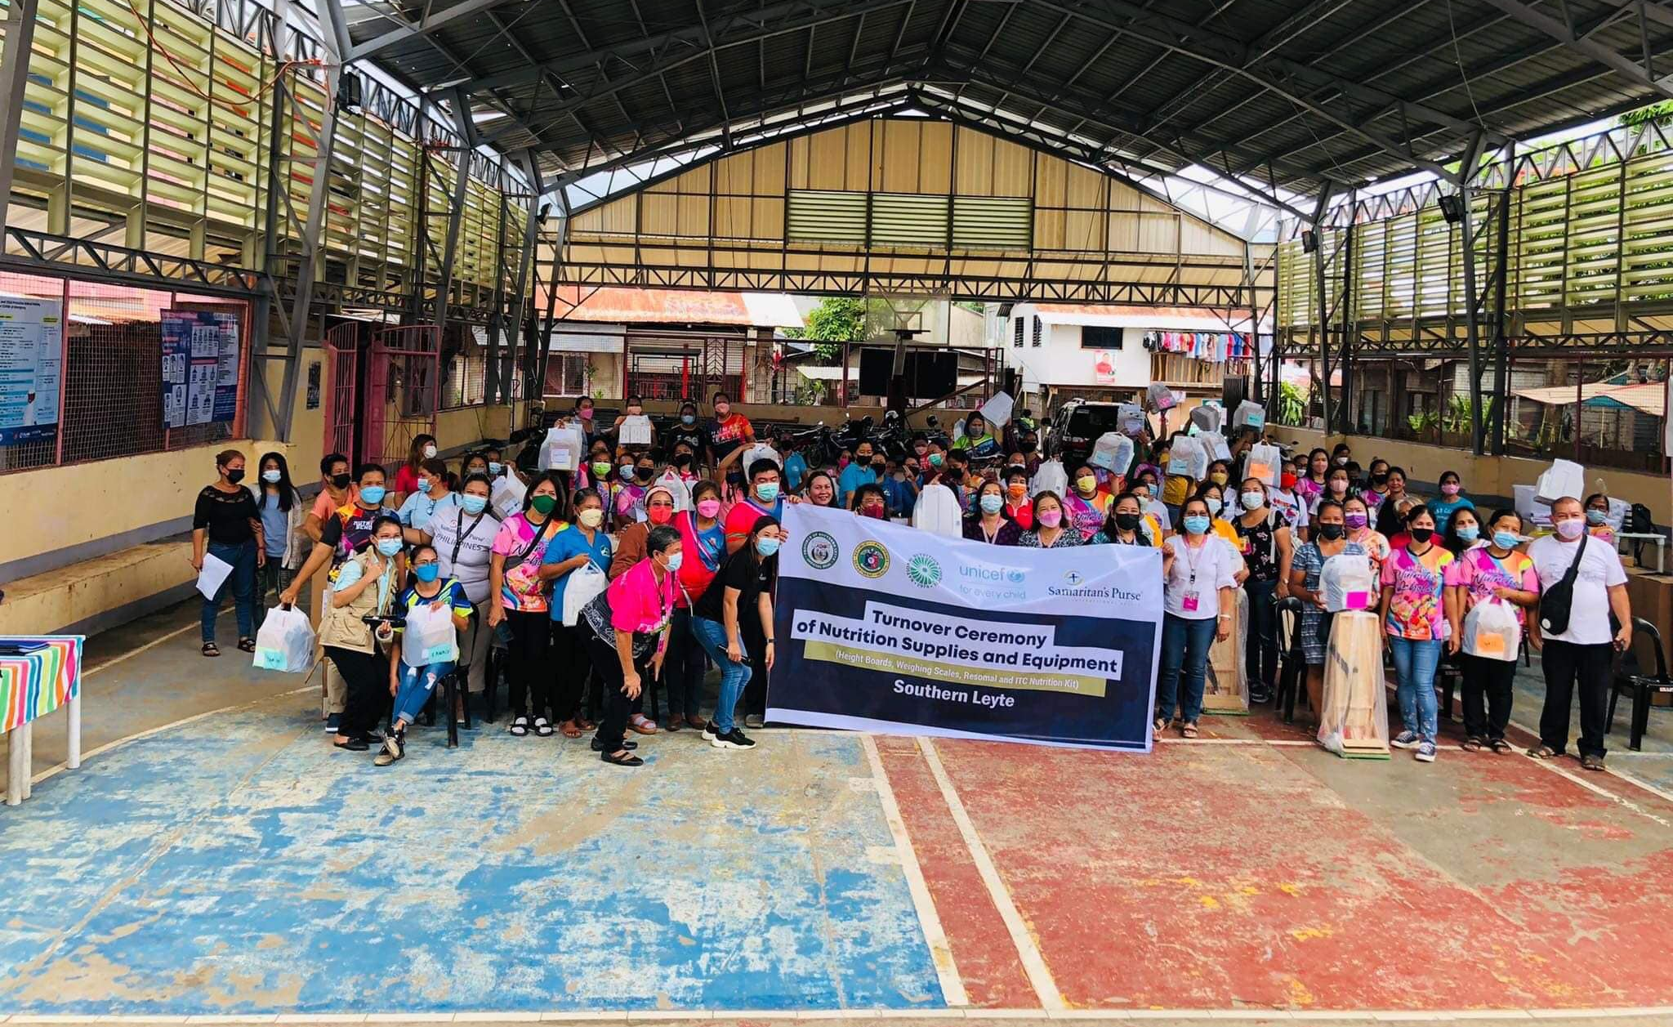
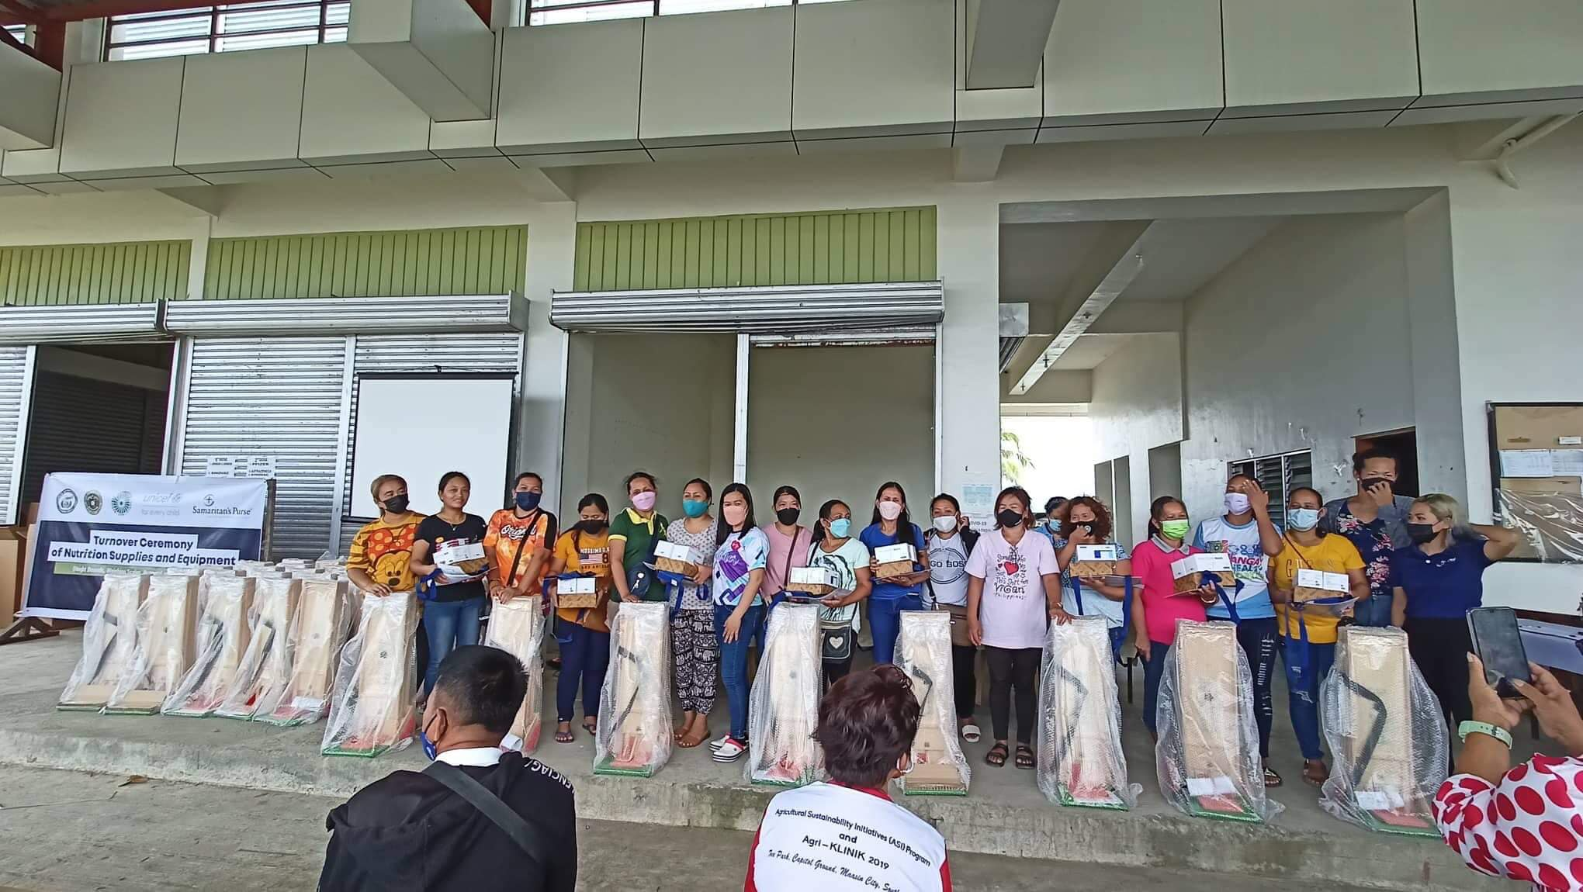
Turnover of Anthropometric Nutrition Supplies and Tools of UNICEF through Samaritan’s Purse

Slide 41
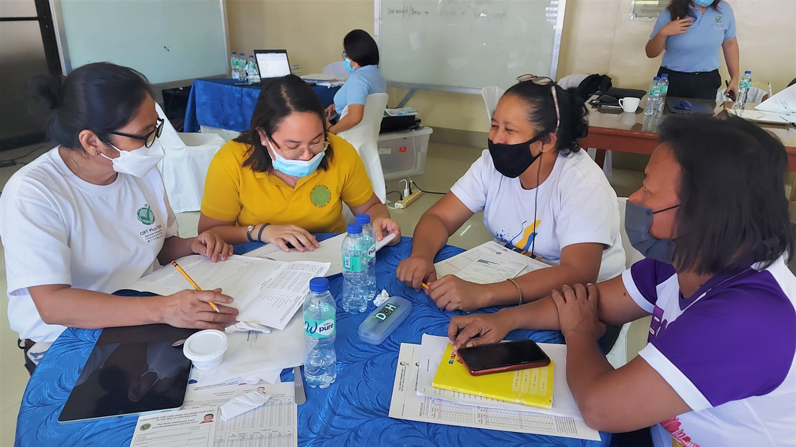
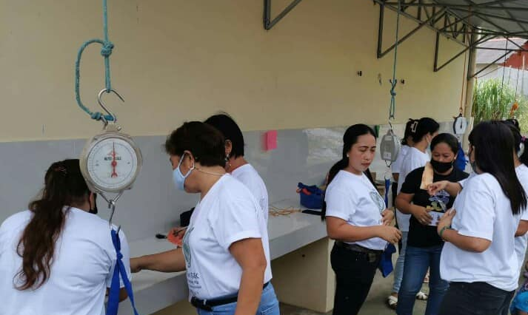
OPT DATA QUALITY CHECK ROLL OUT IN PILOT LGUS

Slide 42
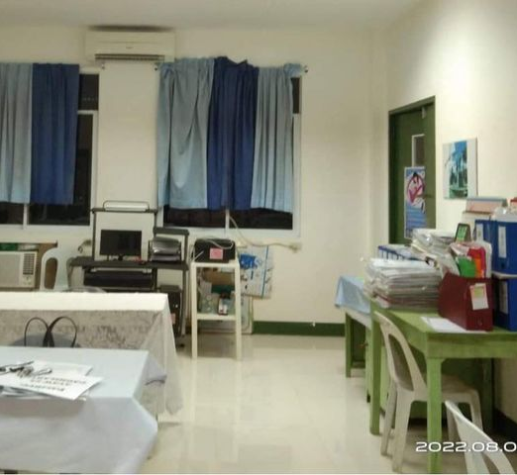
Creation of Nutrition Offices and Plantilla positions for Nutrition Workers

Slide 43
CONSTRAINTS and CHALLENGES
Anthropometric tools used not standardized Or faulty (observed from OPT DQC)
Handwritten type of report (community level) due to unavailability of laptop/phone for input (human/encoding error, inaccuracies in transfer of data)
Unskilled in laptop operations
Late submission of eOPT Report
Coverage: below 80%
Submitted report are not the FINAL REPORTS (discrepancy of data)
E-OPT Report Submitted should be both hard and soft copy

