Slide 1
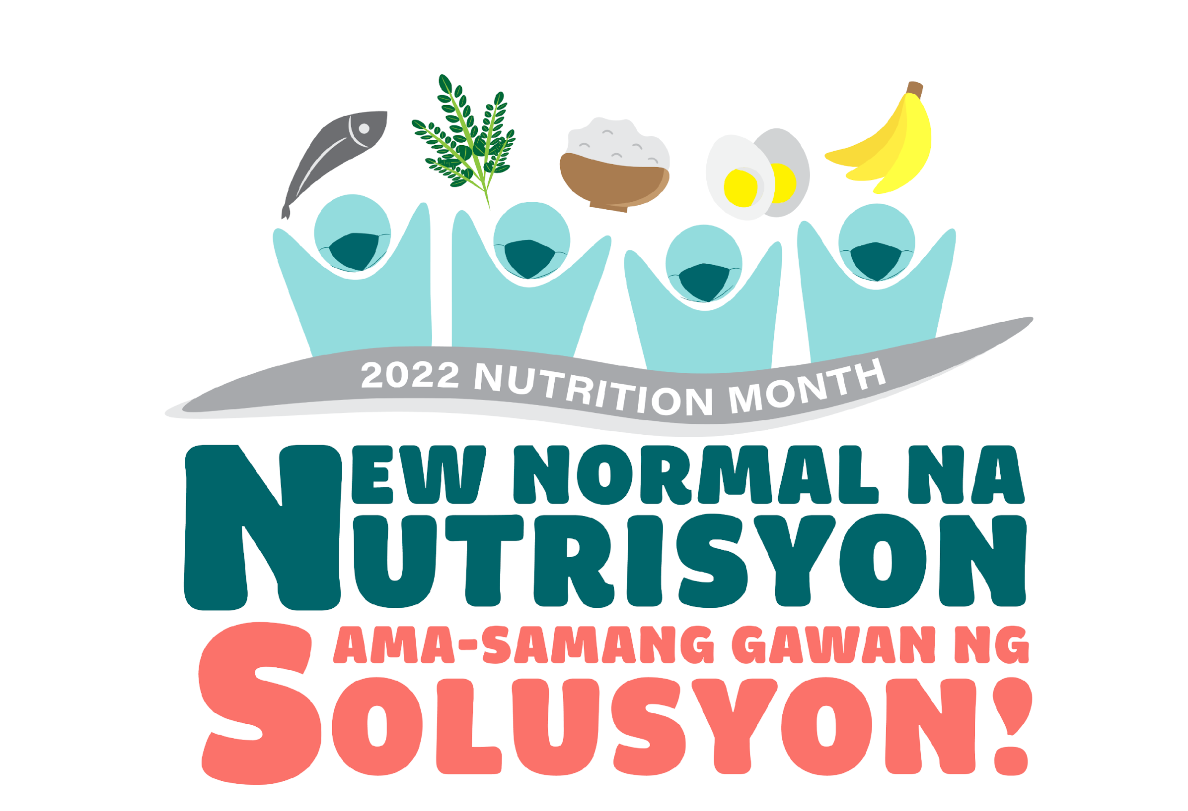


Notes:
Courtesies…
Its Nutrition Month once again! This year’s campaign is guided by the theme “New normal sa nutrisyon, sama-samang gawan ng solusyon!” The theme was approved by the NNC Technical Committee through ad referendum in March. The theme calls for solidarity to address malnutrition in the new normal. It also holds the promise that after this once in a lifetime pandemic, we can recover and build back better through improved nutrition and resilience.

Slide 2
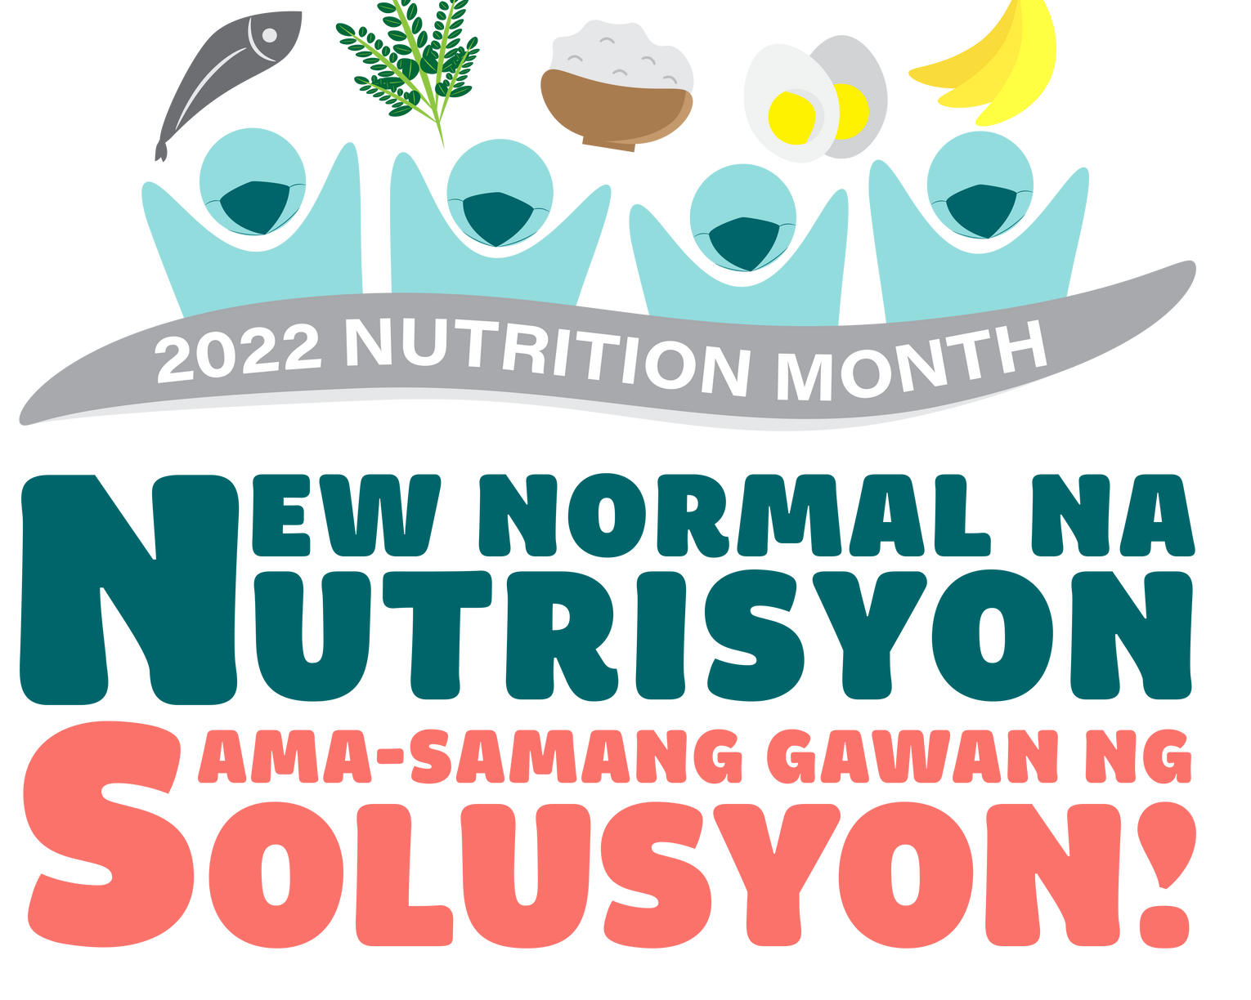
PRESENTATION OUTLINE
About Nutrition Month
How has the pandemic affected nutrition?
How are normal and resilience linked?
The new normal for nutrition
Opportunities for stakeholders
Notes:
I will present the nutrition month campaign particularly its objectives and key messages, how the pandemic affected nutrition, how nutrition and resilience are linked, define new normal and the new normal in nutrition that we want. Lastly, I will share our call for support from among the different sectors so that through our collective effort, we can improve nutrition as we move forward to a better new normal.

Slide 3
2022 NUTRITION MONTH CAMPAIGN OBJECTIVES
Raise the awareness of the importance of nutrition in building resilience and recovery from the pandemic
2. Stimulate discussions among stakeholders on how to build back better the design, delivery, and scale-up of nutrition interventions
3. Engage various sectors and the public in activities that promote nutrition
Notes:
The campaign aims to raise awareness on how supporting nutrition can support recovery from the pandemic as we all build our resistance for future shocks. Second, like in other nutrition month campaigns, we want different stakeholders to talk about how we can build back better nutrition interventions and lastly, we want to engage various sectors so that they too can support nutrition.

Slide 4

KEY MESSAGES
Key Message 1
Key Message 2
Key Message 3
Good nutrition is key to building immunity, protecting against illness and infection, and supporting recovery.
Efforts to preserve and promote proper nutrition must be part of pandemic resilience strategies.
Promote and adopt health-enhancing nutrition behaviors including the consumption of sustainable healthy diets.
Notes:
This year’s campaign aims to drive six key messages for our call to action among stakeholders. The key words in the theme are new normal, nutrisyon and sama-sama. The first three messages pertain to the importance of nutrition to improve an individual’s resistance against disease and at the same time with improved nutrition, the recovery of a family, community and the nation will be supported.

Slide 5
KEY MESSAGES
Key Message 4
Key Message 5
Key Message 6
Call for continued solidarity to support food and nutrition security, especially for the most vulnerable
Expand multi-sectoral engagements to scale-up nutrition interventions
Strengthen leadership and governance in nutrition across all levels to achieve nutritional outcomes of the PPAN.
Notes:
The next set of messages relate to the sama-samang gawan ng solusyon. It calls for solidarity, multi-sectoral engagements and improved governance to be able to attain nutritional outcomes. Because of the pandemic, our solutions to end malnutrition need to have a resilience-lens so that when pandemics or similar shocks occur in the future, Filipinos as able to bounce back and recover quickly.

Slide 6

Target Audience and Key Messages
“Siguruhin ang tamang nutrisyon para sa malakas na resistensya laban sa sakit”
“Magtulungan tayo para labanan ang kagutuman at makamit ng bawat pamilya ang sapat na pagkain at nutrisyon”
“Sundin natin ang health protocols ayon sa itinakda ng autoridad”
Individuals and families
Notes:
These key messages are a bit heavy and so we translate these into bitable actions for various audiences. And we call on you to help NNC spread these to every Filipino. For individuals and families, the call is “Siguruhin ang tamang nutrisyon para sa malakas na resistensya laban sa sakit”. We recognize too that individuals can also help their neighbors and so the call is “Magtulungan tayo para labanan ang kagutuman at makamit ng bawat pamilya ang sapat na pagkain at nutrisyon.” During the lockdowns, we saw how people were willing to share what they have to those who were affected by the pandemic. We hope that this can continue because the nutrition problem and its impact is similar to a pandemic. Third, we also promote the call for continued observance of health protocols as prescribed by the authorities. For example, frequent handwashing will not only prevent covid but other diseases that if frequent can result to malnutrition.

Slide 7

Target Audience and Key Messages
Ensuring the continued and scaled-up delivery of nutrition services:
Establish nutrition office with staff complement including a permanent full-time nutrition action officer
Prepare three-year local nutrition action plan
Include dietary supplementation program for pregnant women and 6-23 months old children
Support Barangay Nutrition Scholars
Issue ordinances that support nutrition
Local chief executives and councilors and members of the local nutrition committees
Notes:
We also target local chief executives, councilors and members of local nutrition committees. We recognize their key role to ensure the continued and scaled-up delivery of nutrition services by
Establishing a nutrition office with staff complement including a permanent full-time nutrition action officer
Preparing the three-year local nutrition action plan and including it in the local development plan and annual investment plans
Including dietary supplementation program for pregnant women and children 6-23 months old
Providing support to Barangay Nutrition Scholars including basic and continuing trainings and incentives; Add more BNS in barangays that are geographically isolated and have higher population, and
Approving ordinances that support nutrition.

Slide 8


Target Audience and Key Messages
Join the Scaling Up Nutrition Movement Philippines as the platform for engagement to scale up nutrition actions
Non-government organizations, private sector, academe
Ensure that nutrition is integrated in sectoral policies/programs
Promote nutrition among workforce and clientele
National government agencies
Notes:
For non-government organizations, private sector and academe, we invite them to join the Scaling Up Nutrition Movement Philippines as the platform for engagement to scale up nutrition actions in the country. The Scaling-up Nutrition is an international movement to call upon stakeholders to invest, inspire and engage actions that increase the reach of nutrition interventions to end all forms of malnutrition.
We also target National government agencies to ensure that nutrition is integrated in sectoral policies and programs and at the same time they must also help promote nutrition among their workforce and clientele.

Slide 9


Target Audience and Key Messages
Enact legislation towards elimination of all forms of malnutrition
    Strengthen nutrition program (amend PD 491)
    Amend PD 1569 (Barangay Nutrition Program and providing for Barangay Nutrition Scholars)
    Providing for a Nutrition Officer and NAO
    Protecting children from harmful marketing of unhealthy food and beverages
    Executive order to implement the PPAN 2023-2028 and one on addressing obesity
Congress and the President
Notes:
Lastly, to Congress and the new President, the call is for the enactment of legislation towards elimination of all forms of malnutrition including these priority legislation:
o Strengthening the nutrition program by amending PD 491 (Nutrition Act of the Philippines)
o Amending PD 1569 or Strengthening the Barangay Nutrition Program and providing for Barangay Nutrition Scholars in every barangay
o Providing for a Nutrition Office and Nutrition Action Officer in every Province, City and Municipality and
o Protecting children from harmful marketing of unhealthy food and beverages.
Also, to the President to issue executive orders to implement the Philippine Plan of Action for Nutrition 2023-2028 and on Addressing Obesity.

Slide 10
How has the COVID-19 pandemic
affected nutrition?
Notes:
Why are we pushing for these messages and call to action? To answer this, we need to know how the pandemic has impacted the country’s nutrition situation which we all know is already challenged with stunting, wasting, obesity and micronutrient deficiencies.

Slide 11
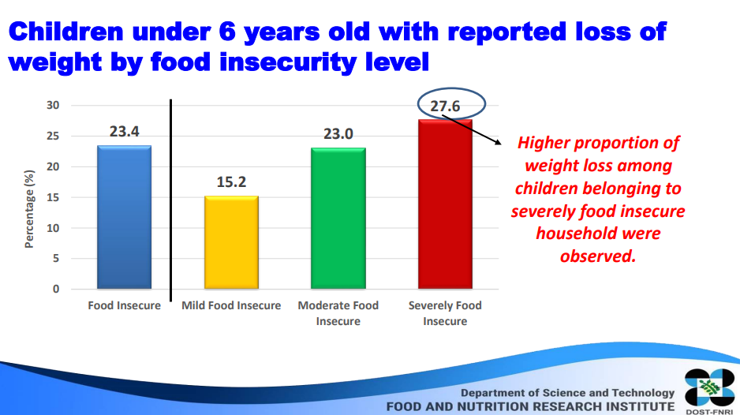
Notes:
The COVID- 19 pandemic has undermined nutrition across the globe as governments imposed various restrictions. In the Philippines, the lockdowns and restrictions limited movement of people, goods and services which essentially slowed the economy. These consequences are bound to impact on nutrition.
First, there is likely increase in malnutrition due to the pandemic. The Rapid Nutrition Assessment Survey (RNAS) conducted by the Department of Science and Technology – Food and Nutrition Research Institute in 2020 reported that loss of weight among children was observed with 2 in every ten children, with a higher proportion among children from severely food insecure households. (For your information, the FNRI has not been able to pursue the annual nutrition surveys in the last two years and was able to conduct only a rapid assessment without any anthropometric assessment.)

Slide 12
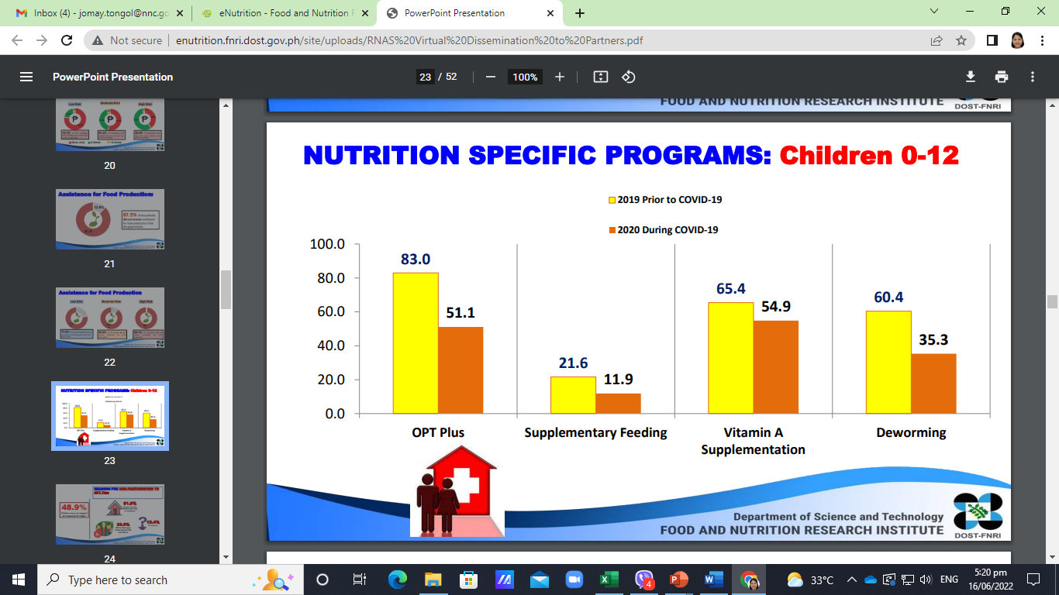
Notes:
Second, the pandemic has caused disruptions in delivery and uptake of nutrition services. The 2020 RNAS revealed that at the time of the survey, infants and pre-school children were highly affected by the disruption of nutrition services. Results show the decrease in the percent of children who received nutrition services such as OPT plus, deworming, supplementary feeding, and vitamin A supplements.

Slide 13
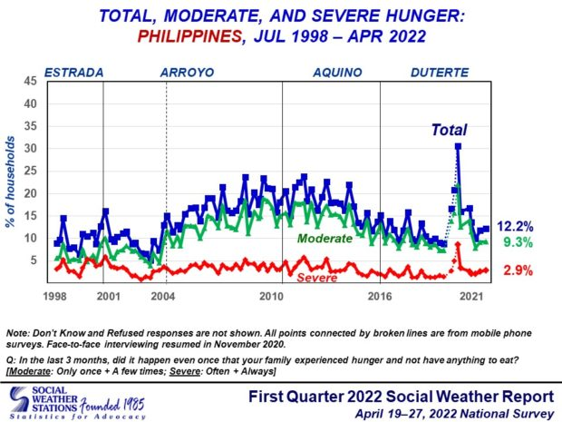
Notes:
Third, the pandemic has caused increased rates of hunger. When the pandemic started, a sharp increase in hunger rates was observed in the SWS surveys on hunger incidence. In the latest survey in the first quarter, 12.2% of Filipinos or an estimated 3.1 million families experienced hunger during the survey period..

Slide 14
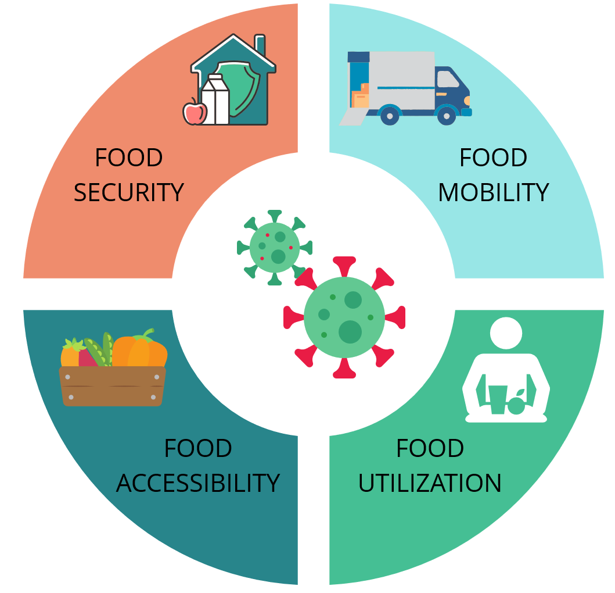
Food security
Food supply chain disruption
Low supply, high demand for food
Higher prices
Reliance on food packs
Limited to no budget to buy food
AVAILABILITY
Hoarding
Online shopping and food delivery
Stress eating
Preference for whole foods
Notes:
Fourth, the pandemic has affected food security. These include disruptions to food supply chains, loss of income and livelihoods, a widening of inequality, disruptions to social protection programs, altered food environments, and uneven food prices. The disruption to the food supply chains affected food availability where food commodities could not reach markets, creating low supply and high demand and resulting in a higher price of some basic goods. People also relied on food packs from government or private donors. Accessibility was also affected. Based on the 2020 RNAS, there are about 56.3% of Filipinos who had problems accessing food due to limited or no budget (22.1%), limited public transportation (21.6%), loss of job (19.5%), or limited food stores in their respective areas (10.8%), and no other members in the family to buy food (5.1%). There were also changes in food mobility as there was an increase in food delivery services and online shopping. Food utilization was also affected. People stayed at home, became bored and tended to overeat especially foods that are high in fats, sugars and salt. Some resorted to stockpiling or hoarding food due to grocery shopping restrictions. On the other hand, some preferred to eat fresh foods and cook at home daily.

Slide 15


Positive impacts
A. Innovation in service delivery
Mode of health and nutrition consultations (telemedicine)
Digital technology - accelerated communication
and greater access to information and knowledge
(online learning)
Notes:
The negative impact of COVID-19 on health and nutrition has been pervasive and undeniably challenging to different sectors. However, there are still positive changes that have been made by living with the virus that can be brought as we shift from pandemic to endemic paradigm.
There were innovations in service delivery especially of medical services. Telemedicine and other digital technology were utilized to facilitate greater access to information and knowledge. We are now used to attending webinars and online trainings.

Slide 16


B. Attitude towards health and nutrition
Benefit of proper nutrition to boost immunity
Families have more time together
More health-conscious, develop healthy habits
Importance of physical and mental fitness at forefront
Notes:
As society changed, attitudes towards health and nutrition also shifted to boost health and prevent getting the virus. The benefit of proper nutrition was emphasized. Families had more opportunities to spend time together due to lockdown. People also became more health conscious to lessen the risk of getting the virus or the severity of the illness. The importance of physical and mental fitness was brought to the forefront of people's consciousness, giving it time and attention. Many engaged to workouts while in quarantine to stay fit and healthy amidst the pandemic.

Slide 17

B. Attitude towards health and nutrition
Food security as a primordial need
Home food gardening emerged
(plantita/plantito)
Solidarity among neighbors
Notes:
In the threat of COVID, food security was recognized as a primordial need of the country given the less accessibility and higher prices of food. Many plant lovers and nurturers or what we call plantito/plantita have also emerged during the pandemic, and lastly, solidarity among neighbors was seen as all citizens were asked to act responsibly. We hear stories of the community pantry being replicated in many parts of the country. Even before the pandemic, there are many individuals or groups who support victims of disasters and emergencies.

Slide 18
What are the changes in nutrition interventions during the pandemic
Issuances to ensure continuous delivery of services (DOH Circular 2020-167, DSWD Memo 12 S. 2020, DepED Order 031 S. 2021)
Tweaking the design of programs (School-Based Feeding Program)
Stronger enforcement of laws such as the Milk Code
Notes:
Because the focus was on pandemic response, the delivery of nutrition and related services was affected. In response, national government agencies released various issuances for continued delivery of essential health services with strict observance of infection control measures. The prohibition on mass gatherings and strict quarantine restrictions did not prevent the implementation of the DSWD and DepED supplementary feeding programs. The designs were tweaked for example, instead of hot meals, healthy food packs were distributed to parents or to the houses of students. Schools served the enhanced nutribun, milk, and fruits. Also, responding to calls for milk donations, the DOH issued Memorandum No. 2020-0231 to provide guidelines on the standardized regulation of donations related to Executive Order 51. The Milk Code does not allow for milk donations as this undermines the practice of breastfeeding.

Slide 19
What are the changes in nutrition interventions during the pandemic
4. National Nutrition Cluster advisories
    Promote consumption of healthy diets, increase physical activity and prevent sedentary behaviors; and adequate sleep
    Prioritize nutritionally vulnerable groups and areas for assistance
    Continued breastfeeding following health protocols
    Family food packs to contain age-appropriate and culturally appropriate, clean and nutritious food items including fresh vegetables and fruits
    Conduct inventory of prepositioned nutrition commodities
Notes:
The NNC as Chair of the National Nutrition Cluster issued advisories to local government units to provide guidance relative to COVID-19 and local nutrition programs. Some of the guidelines included topics such as following healthy diets, continued breastfeeding, following the COVID 19 health protocols and conducting an inventory of prepositioned nutrition commodities.

Slide 20
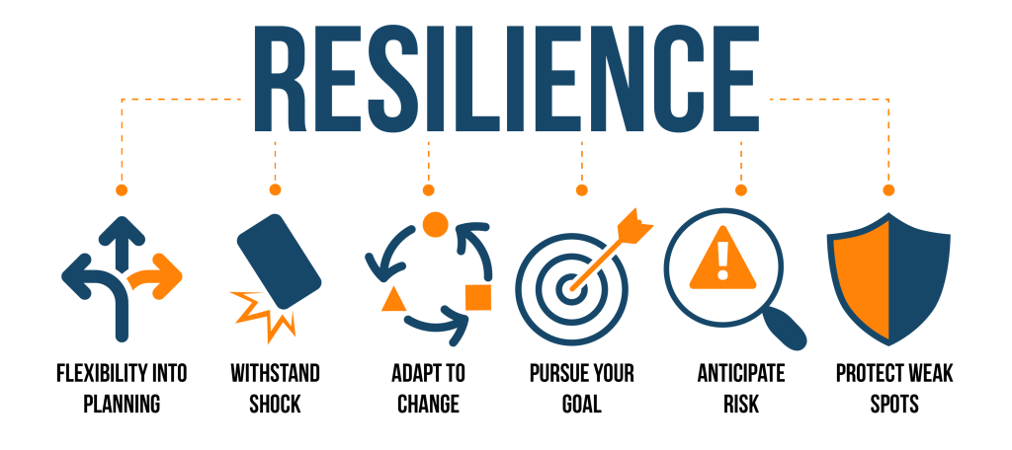
Graphic accessed from: https://researchoninvestment.com/resilience-in-the-face-of-change/
Notes:
Transitioning to the new normal means that we need to improve resilience of the individuals, families, communities and the whole country. Resilience in general, means the ability and willingness to adapt over time to a changing and potentially threatening environment.

Slide 21
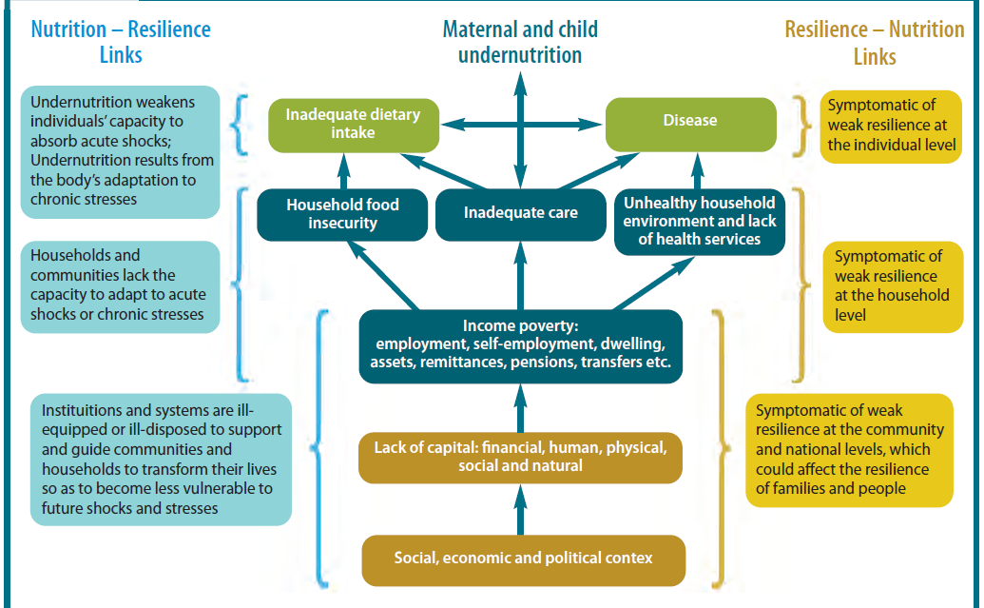
Improved nutrition
Improved resilience
Source: Nutrition and Resilience: A Scoping Study , Emergency Nutrition Network, 2015
Notes:
We can see in this illustration the link between nutrition and resilience. Undernutrition weakens the individual, household and community capacities to adapt to acute shock or stress. Institutions and systems are not yet conditioned to provide support to families and communities to transform their lives to be less vulnerable to shocks and stresses. At the same time, the factors that cause weak resilience are also signs of the causes of child and maternal undernutrition. Undernourished families in poor communities have low resilience.

Slide 22

Nutrition and Resilience
Nutrition is both an input to and an outcome of resilience
Nutrition and resilience are co-dependent and mutually reinforcing
Integrating resilience thinking to nutrition programming and vice versa would have higher benefits
Improving resilience at the country level can also address factors affecting malnutrition.
Improved nutrition
Improved resilience
Notes:
Therefore, nutrition and resilience are strongly interlinked where nutrition is both an input as well as an outcome of resilience.
Nutrition and resilience are co-dependent and mutually reinforcing. Integrating resilience thinking to nutrition programming and vice versa would give greater benefits. On the other hand, improving the resilience of a country can also address factors affecting malnutrition, thus, improved resilience means improved nutrition

Slide 23
Quezon City: an example of integrated food and nutrition-sensitive programming for resilience
Overnutrition and hidden hunger among children are main nutritional concerns
Anti-Junk Food and Sugary Drinks Ordinance to ban marketing and trade of unhealthy food around schools (2017)
Signatory to Good Food Cities Declaration together with 12 other cities in the world
During pandemic: food relief, Community Mart app and Fresh Market on Wheels program to maintain food value chain from farm to market as short-term response
Food Security Task Force worked on Urban agriculture: household, community, and institutional gardens and commercial farms to address food insecurity complemented with food trade and processing
Plan to develop a food security and resilience plan
Towards a new normal where healthy and sustainable foods are the primary available choice
Notes:
To drive this point, Quezon City serves as an example of food and nutrition-sensitive programming to build resilience. Quezon City is the most populous and richest city in Metro Manila. Its main nutritional concerns are overnutrition and micronutrient deficiencies among children. Over the course of more than 10 years, the city has gradually moved towards providing a healthier food environment for its population so much so that it was one of 13 cities that was a signatory to the Food Cities Declaration in the world. It is one of the first cities to issue an ordinance to ban the marketing and trade of unhealthy foods around schools. At the start of the pandemic, it embarked on short term response such as food relief, Community Mart App and mobile markets. Quezon City organized its Food Security Task Force to address food insecurity, promote consumption of nutritious food, complementing and creating livelihoods and building climate resilience. The response focused on urban agriculture complemented with food trade and processing. The city plans to develop a food security and resilience plan for the long-term response. Its goal for the new normal is to have healthy and sustainable foods to be the primary available choice.
This is just one LGU that has been documented by EAT and UNICEF. We hope that there will be more LGUs like it. Sana all.

Slide 24

What do we aim for nutrition in
the new normal?
1
Raise awareness of the importance of nutrition in building resilience
Better design, delivery, and scaling up of nutrition interventions
Promote adoption of health-enhancing nutrition behaviors including
consumption of sustainable healthy diets
Increased support in food and nutrition security, especially the most vulnerable
Eradicate hunger and malnutrition
Prevent and manage of non-communicable diseases (NCDs)
2
3
4
5
6
Notes:
Maximizing the nutritional impact of resilience programming will involve resilience-building programs and policies that will also address and prevent all forms of malnutrition. In this context, we strive for a better nutrition in the new normal. This can happen when first we raise the awareness on the importance of nutrition in resilience building. The relationship of nutrition and resilience is unquestionable and a food and nutrition secured population is more resilient in times of disaster and able to adapt to stress without applying negative nutritional coping strategies.
Second, the occurrence of disasters and emergencies are inevitable. It affects all aspects of life including the delivery of health and nutrition services. With this disruption, evaluation and re-planning on how nutrition intervention can be delivered amidst any emergency should be done to continue implementation and ensure that the nutritional needs of the population will be met. We must BUILD BACK BETTER nutrition.
Third, Aside from standard health protocol, enabling the population to eat a variety of whole foods including fruits and vegetables, meat, poultry, fish, and dairy, reducing sugar and salt intake, cutting back on high fat foods and staying hydrated will help improve resilience.
Fourth, we saw how the food security of families and communities were affected, we must work towards sustainable food systems that improve both availability and access to nutritious foods.
Fifth, With or without the presence of the pandemic, it is essential to eradicate hunger and all forms of malnutrition as these are obstacles to a healthy growth and development and may cause irreversible damage to individuals. Eradicating hunger and malnutrition will also lead to improved children and adult nutrition that will further lead to economic benefits such as increased productivity and earnings
Lastly, we also aim to prevent and manage non-communicable diseases (NCDs) as these pose higher risk to death and can result to poverty which families may not be able to recover from. NCDs can be prevented by avoiding risk factors such as tobacco and alcohol use, unhealthy diet and physical inactivity.

Slide 25
Opportunities for nutrition in the new normal
Advocacy under new leadership at the national and local levels
Full devolution under Executive Order No. 138
Development of successor PPAN for 2023-2028 and its operationalization at the local level through local nutrition action plans
Notes:
What are the opportunities for nutrition in the new normal?
First, as the new administration starts in July both in national and local level and with the transition of the country from the pandemic to endemic mode, elected officials are called upon to exercise their powers to ensure building back better for nutrition and to prioritize nutrition as a crucial factor in resilience-building.
Second, the Mandanas-Garcia Ruling and Executive Order 138 moves for full devolution of services, local government units are expected to strengthen the integration of nutrition specific and nutrition sensitive program to its local nutrition action plans and address the gaps and challenges of PPAN implementation.
Lastly, the National Nutrition Council (NNC) Governing Board s expected to issue the Philippine Plan of Action for Nutrition (PPAN) for 2023-2028 by the latter part of 2022. The PPAN serves as the country's blueprint for achieving nutritional adequacies for all Filipinos and is a component of the Philippine Development Plan. The formulation of the PPAN shall consider resilience building strategies to improve food and nutrition security and end all forms of malnutrition.

Slide 26
What are the roles of stakeholders to help improve nutrition towards a better new normal?
Notes:
What can be done to make nutrition better in the new normal and who can support this?

Slide 27
Opportunities to support nutrition:
National government agencies
Commit to actions toward eliminating malnutrition and building back better moving forward to the new normal
Integrate nutrition in the development of resilience-building programs, policy and framework for disaster risk management
Develop and strengthen policies and programs on scaling up nutrition interventions and highlight importance of nutrition in building resiliency
Notes:
At the national level, national government agencies can support by committing actions toward eliminating malnutrition, integrating nutrition in resilience-building strategies and program and strengthening policies and programs on scaling up nutrition interventions and highlighting importance of nutrition in building resiliency,

Slide 28
Opportunities to support nutrition:
National government agencies
Invest in nutrition through the inclusion of nutrition programs in the national annual budget, operational plans, and human resources
Include nutrition lens in development of resilience-building programs and policies
Continue to tweak programs to become nutrition-sensitive
Prioritize nutritionally vulnerable groups as beneficiaries in nutrition specific and nutrition-sensitive government programs
Notes:
It is also important for NGAs to invest in nutrition, have a nutrition lens in resilience-building programs. For some NGAs, they can continue to tweak their policies and programs to become nutrition-sensitive. And lastly by prioritizing nutritionally vulnerable groups as beneficiaries of their programs.

Slide 29
Opportunities to support nutrition:
Local government units
  Formulate and implement local nutrition action plans that align with the PPAN 2023-2028 and with a resilience lens
  Increase support to nutrition programs and their implementation taking in considerations changes in the delivery brought by the pandemic
  Improve access to nutrition and related programs in far-flung areas, geographically isolated and disadvantaged areas, urban poor, and resettlement areas
Notes:
At the heart of PPAN are the local government units and within them lie the success of the PPAN. Local chief executives, Nutrition Action Officers, members of the local nutrition committee and volunteer workers such as the Barangay Nutrition Scholars are called upon to ensure that their local nutrition action plan aligns with the new PPAN 2023 – 2028. We also call on LGUs to reach the far-flung areas, urban poor and resettlement areas which are most at risk to malnutrition.

Slide 30
Opportunities to support nutrition:
Private sector
Modify budget and plans to include nutrition-related activities and services to employees and clientele
Work with government to fill the gap in terms of delivery of nutrition services and intervention
Notes:
For the private sector, support nutrition by including nutrition related activities in your budget and plans and by working with the government in filling in the gap in terms of delivery of nutrition services and intervention

Slide 31
Opportunities to support nutrition: Media
Develop materials for information, education, and communication of nutrition messages to the public
Promote good and healthy nutrition practices in commonly consumed media
Encourage the public to participate in national and local health and nutrition programs
Stop calling for donations of milk formula contrary to the Milk Code
Notes:
Media can play a big role in disseminating nutrition related information and healthy nutrition practices. They can also encourage the public to participate in various local nutrition programs and help in the implementation of Executive Order 51 also known as the Milk Code

Slide 32
Opportunities to support nutrition:
Civil society
Advocate for increased attention to food and nutrition security
Empower communities to support programs for malnutrition and scaling up nutrition in the new normal
Work with government to strengthen efforts to end malnutrition
Widen the reach of nutrition programs to areas with less access
Join the Scaling Up Nutrition Civil Society Alliance
Notes:
Civil society groups can help advocate for increased attention to food and nutrition security. They can work with the government and help empower communities especially those with less access to health and nutrition programs. They may also join the Scaling Up Nutrition Civil Society Alliance.

Slide 33
Opportunities to support nutrition:
Academe
Conduct webinars, online fora and other activities to increase awareness on malnutrition prevention and importance of nutrition in recovery;
Involve school and university constituents in participation in malnutrition reduction and promotion nutrition programs;
Include extension programs that promote good nutrition to the public;
Notes:
For the academe, conducting webinars, online fora and other extension program to promote good nutrition and increase awareness on malnutrition prevention can be done. You may also highlight the importance of nutrition in recovery and resilience building.

Slide 34
Opportunities to support nutrition: Academe
Improve information dissemination on nutrition in the curricula
Mobilize school-based groups and student organizations in their initiatives on the promotion of good nutrition
Join the Scaling Up Nutrition Academe Network
Notes:
You can also mobilize school-based groups and student organizations in their initiatives on the promotion of good nutrition. Aside from the said activities, you can also join the Scaling Up Nutrition Academe Network.

Slide 35
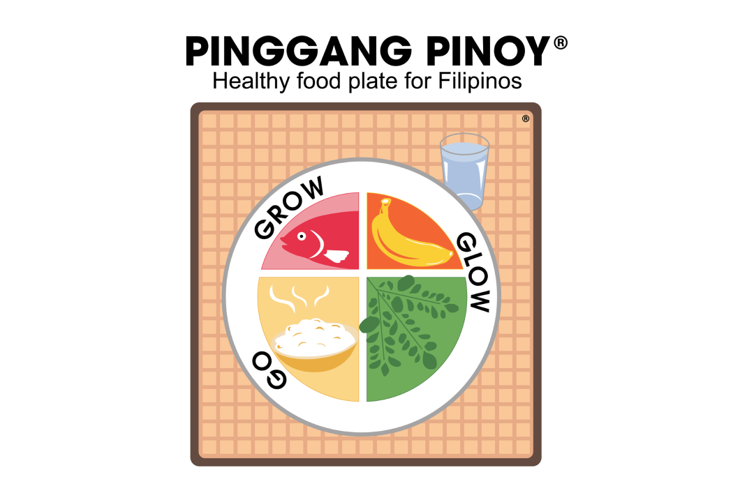

Opportunities to support nutrition:
Individuals and Families
Eat a healthy and well-balanced diet using the Pinggang Pinoy as guide
Increase the consumption of foods rich in Vitamins A, C, E, B6 and B12 such as citrus and dark green leafy vegetables
Maintain an active lifestyle
Avoid smoking, alcohol, and drugs
Drink 8-10 glasses of water every day and avoid sugary drinks
Notes:
Lastly, for individuals and families, you can follow these practices to ensure proper nutrition and be part of the campaign toward better nutrition in the new normal.

Slide 36
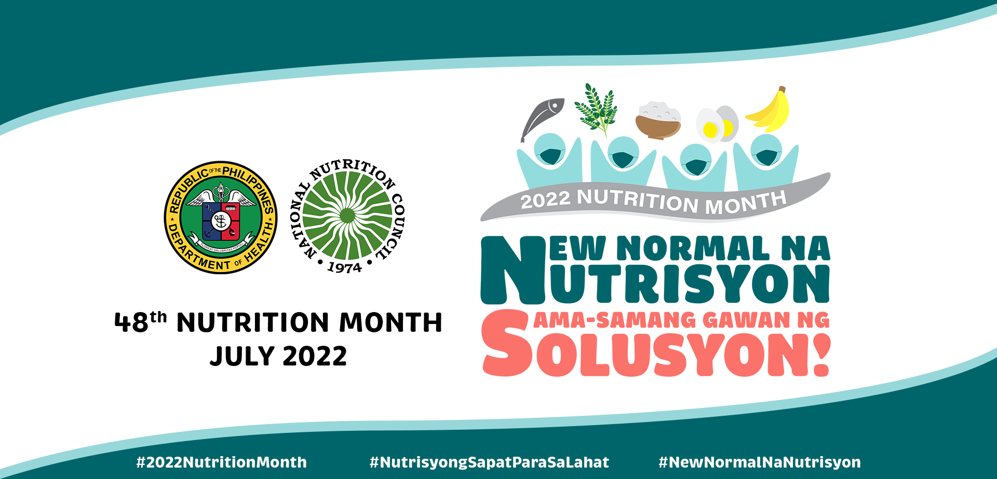

Ways to support Nutrition Month
Disseminate information about Nutrition Month by hanging streamers or posting banners in websites; billboards and other signages in building facades or in high foot traffic areas
Maximize the use of social media
Participate in Nutrition Month activities of the NNC, other agencies, workplace, schools and your local government unit or community
Notes:
And before I close, let me share suggested activities by which you or your community or organization can do during Nutrition Month. Help disseminate information about Nutrition Month in whatever channel available to you. Maximize the use of social media to help disseminate nutrition month activities. You can also participate in Nutrition Month activities of the NNC, other agencies, workplace, schools and your local government unit or community.

Slide 37
Ways to support Nutrition Month
Conduct webinars and online fora
Conduct special events (motorcade, fun run, cycling, parade and sporting events) tweaked to highlight nutrition messages
Conduct drills to help people become prepared for emergencies as July is also National Disaster Awareness Month
Sharpen nutrition knowledge through conduct of quizbees on nutrition especially among students and even parents
Notes:
You can also conduct webinars, online for a or even special events such as motorcade, fun run and other physical activities tweaked to highlight nutrition message. You can also conduct drills to help people become prepared for emergencies as July is also National Disaster Awareness Month.

Slide 38
Ways to support Nutrition Month
Highlight special talents by having various contests or local concert
Use visuals such as having, painting murals on walls/fences along major streets; exhibits showcasing good practices on nutrition programs
Generate resources for community nutrition programs through fund-raising events
Notes:
You can also support the Nutrition Month by sharpening your knowledge on nutrition by conducting quiz bees on nutrition or even through various contests involving nutrition topics. Feel free to use visuals to exhibit good nutrition practices. And lastly, you can also generate resources for community nutrition programs through fund-raising events.

Slide 39

Activities for Nutrition Month
SUN | MON | TUES | WEDS | THUR | FRI | SAT
 |  |  |  |  | 1 | 2
3 | 4 | 5 | 6 | 7 | 8 | 9
10 | 11 | 12 | 13 | 14 | 15 | 16
17 | 18 | 19 | 20 | 21 | 22 | 23
24/31 | 25 | 26 | 27 | 28 | 29 | 30
1 July
Nutrition Month Kick Off
July
Regional Nutrition Month Launch
Notes:
Please also mark your calendars for the following activities as we celebrate the Nutrition Month. We will kickstart the 48th Nutrition Month celebration on July 1 with an online event. Many of the NNC regional offices will have regional launch events on July 4.

Slide 40
Activities for Nutrition Month
Online Contests
4-25 July
Facebook Digital Art Contest
4-25 July
Facebook Photo Contest
4-25 July
Tiktok Contest
25-28 July
Online Nutrition Hackathon
Notes:
The Kick off event will also serve to announce NNC’s online contests. We have the Facebook digital art contest, photo contest and tiktok contest. We will also be conducting the first ever Online Nutrition hackathon on July 25-28 so you better watch out for that. Our regional offices have likewise a line-up of online activities for their constituents.

Slide 41
Activities for Nutrition Month
1-29 July
Social Media Posting
1, 15, 22, 29 July
Text Blast Messages
29 July
Nutrition Month Culminating Event
Notes:
We will also have month long activities to disseminate key messages of the nutrition month such as text blast messages and social media posting then the culminating event by July 29.

Slide 42
Activities for Nutrition Month
5-8 July
FNRI Seminar Series
10 July
Gawad Kalinga National Feeding Day
20-21 July
DOH and DOH League of RNDs Inc.
Advocacy Webinar
26-27 July
Phil. Association of Nutrition Convention
Notes:
Partners have also lined up activities to support nutrition month. Check the social media pages of these institutions.

Slide 43
Notes:
I hope that with this presentation, you are now super excited to support this year’s Nutrition Month campaign. Please support new normal na nutrisyon and be part of the solusyon.

Slide 44
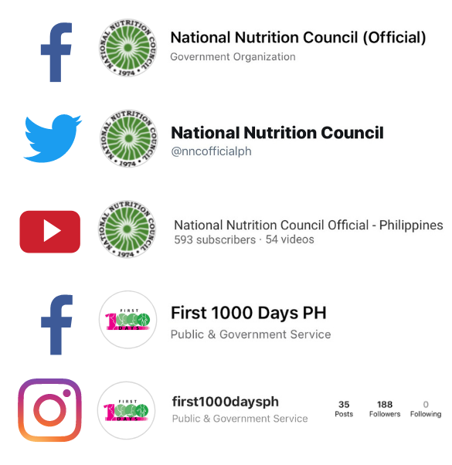

For more information, please contact
NATIONAL NUTRITION COUNCIL
Nutrition Bldg., 2332 Chino Roces Avenue Extension, Taguig City
(632) 8843-0142
http://www.nnc.gov.ph
Notes:
Thank you so much. For more information, please contact us using these information.
Again, a meaningful nutrition month and once more, New normal na nutrisyon, Sama-samang gawan ng solusyon!
Have a good day!

