Slide 1
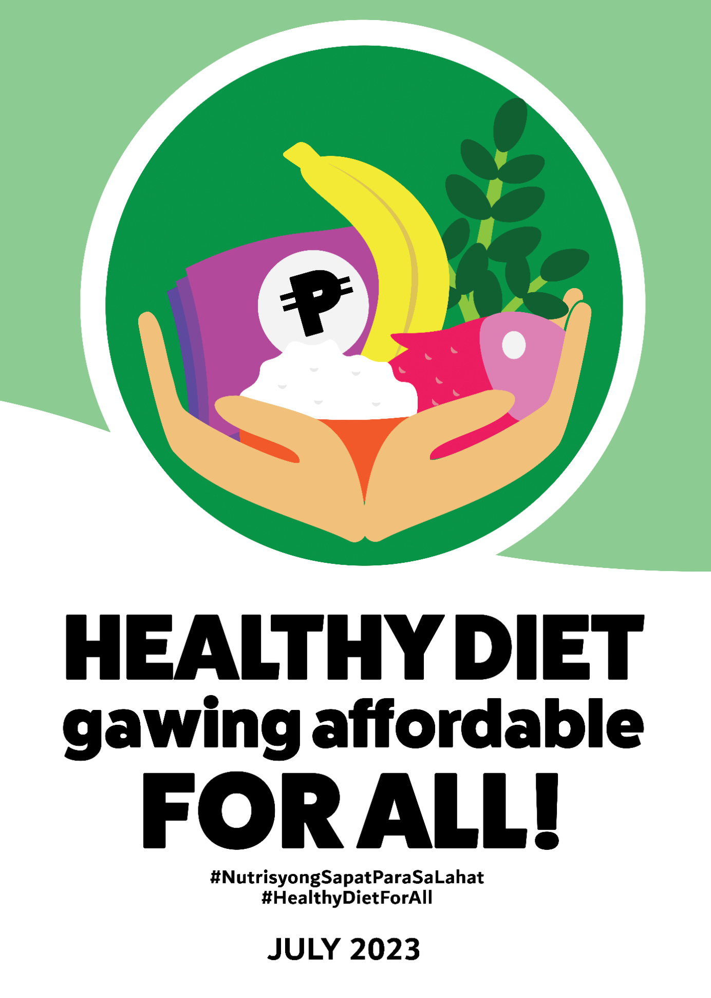

49th
Nutrition
Month
Notes:
Courtesies and greetings…
Pangarap na lang ba ang healthy diet for the mga Pinoy? This Nutrition Month, we focus on two elements. First healthy diets and second how affordable these are for Filipinos. In this presentation we will answer if Filipinos can afford healthy diets, what are healthy diets? And more importantly how do we move forward?
But first, tignan ninyo ang mga sitwasyon na ito.

Slide 2

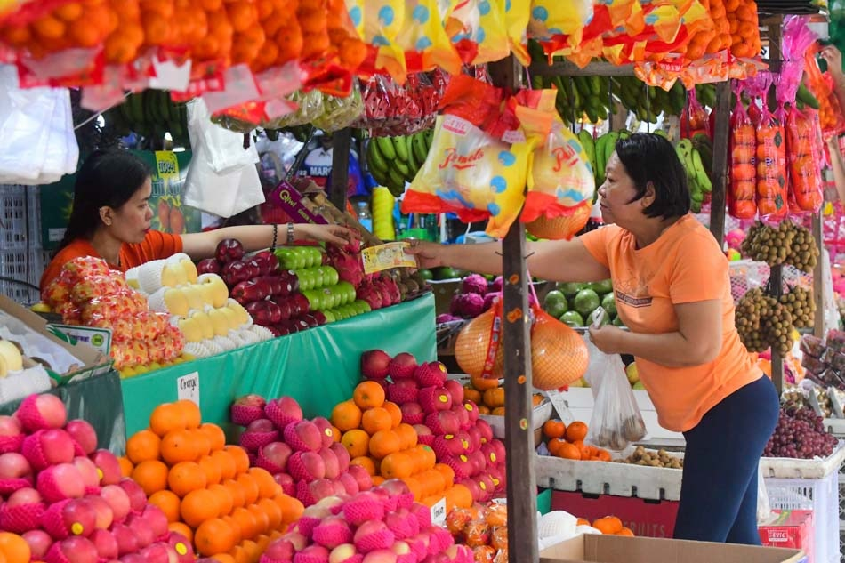
Bakit ba tuwing New Year, super bili tayo ng prutas?
Kasi pampa-swerte!
Kung nagbibigay swerte, bakit hindi araw-araw kumain ng prutas?
Photo accessed from: https://news.abs-cbn.com/news/multimedia/photo/12/27/22/buying-round-fruits-for-new-year
Notes:
Bakit nga ba every New Year, naloloka tayo sa pagbili ng prutas? Dahil pampaswerte daw. Pero kung nagbibigay swerte ang prutas, bakit hindi na lang araw-araw bumili ng prutas?

Slide 3
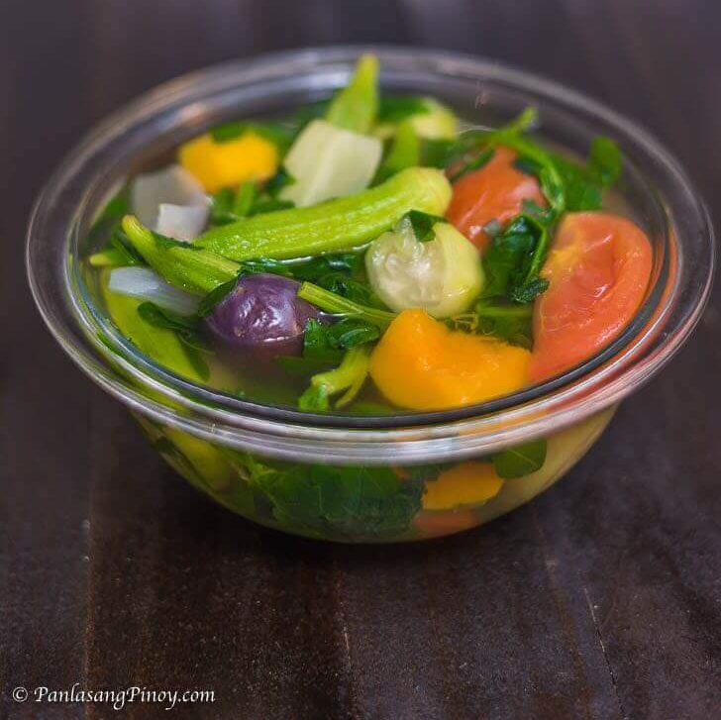
Anong ulam?
Gulay
Walang karne?
Mayaman ka ba?
Photo from: https://panlasangpinoy.com/23-easy-filipino-vegetable-recipes/
Notes:
Samantala, may mga tao naman na ang tingin sa gulay ay hindi ulam. Hindi kumpleto ang pananghalian o hapunan kapag walang karne.

Slide 4
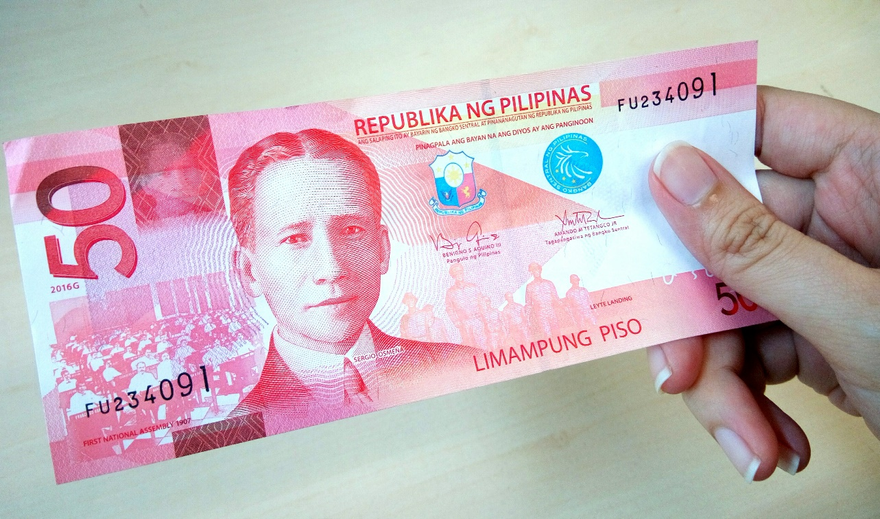
Pagkain?
Load?
Lotto?
Yosi?
Photo from: https://www.modernfilipina.ph/careers/money-investments/the-50-peso-saving-challenge
Notes:
Kapag may pera naman, saan ito napupunta? Sa pagkain ba o sa ibang bagay?

Slide 5
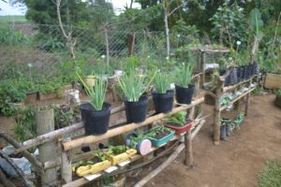
Magtatanim?
Mag-tongits?
Mag-tagay?
Matulog?
Mag-Marites?
Photo from: https://fo10.dswd.gov.ph/lgu-hopeful-to-solve-malnutrition-through-gardening/
Notes:
Pwede naman magtanim ng pagkain sa bahay pero bakit nga ba ang iba maraming dahilan o mas gusto na lang gumawa ng iba?

Slide 6
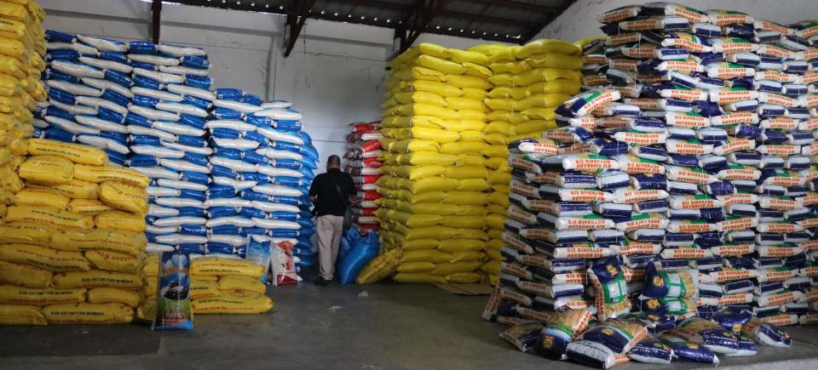
To import?
Not to Import?
Photo from: https://ptvnews.ph/5-asian-firms-seen-to-bag-rice-supply-contracts/sacks-of-rice/
Notes:
But these choices are not confined to the individual, policy makers also have to make decisions such as whether we import or not to import rice. In any decision, there will be positive and negative consequences. These decisions at the family to the national level impact on whether or not Filipinos can afford a healthy diet.

Slide 7
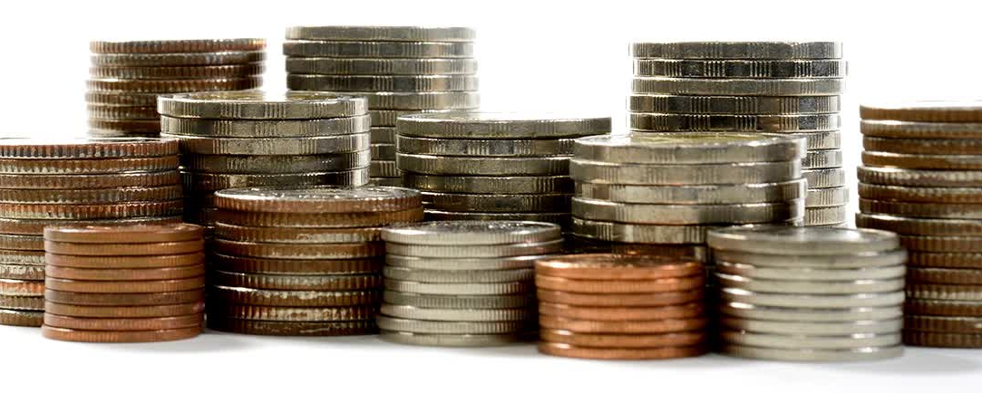
Food affordability
Capacity to pay a market price for food compared to the proportion of a household’s income and other expenses
Notes:
When we talk of food affordability it deals with the capacity to buy food compared to other expenses given a certain income.

Slide 8
Poverty incidence of families and of population, 2015-2021
Notes:
Simply put, if a family does not have income, they cannot afford to buy all their food requirements. 18 in every 100 Filipino households do not have enough money to meet their needs, both food and non-food.

Slide 9
Mean food cost of households, by major food group and wealth quintile,2018-2019.
Food Group | All | Poorest | Poor | Middle | Rich | Richest
Cereals and cereal products | 71.5 | 66.9 | 68.8 | 69.7 | 72.5 | 82.4
Rice and rice products | 50.4 | 49.3 | 50.1 | 50.1 | 50.4 | 52.4
Starchy roots and tubers | 2.2 | 1.6 | 1.2 | 1.0 | 2.8 | 4.2
Sugars and syrups | 4.0 | 2.0 | 3.8 | 3.9 | 4.5 | 5.5
Fats and oils | 5.3 | 3.9 | 4.6 | 5.2 | 6.2 | 7.3
Fish and fish products | 42.8 | 32.3 | 28.0 | 43.2 | 47.1 | 58.1
Meat and meat products | 37.1 | 14.3 | 24.4 | 37.7 | 49.8 | 62.4
Poultry | 18.1 | 7.8 | 12.2 | 17.1 | 25.3 | 33.0
Eggs | 10.4 | 7.4 | 10.6 | 10.7 | 11.2 | 13.0
Milk | 11.1 | 4.8 | 7.3 | 10.0 | 14.5 | 22.1
Vegetables | 26.6 | 22.5 | 24.0 | 25.8 | 28.4 | 34.4
Fruits | 5.6 | 2.9 | 3.7 | 5.0 | 6.5 | 11.3
Others | 18.9 | 14.1 | 27.2 | 19.9 | 17.2 | 32.1
Total | 253.6 | 181.3 | 215.6 | 250.1 | 286.0 | 365.8
Source: DOST-FNRI (2022a). From Briones, R. [18]
Notes:
This data shows that money spent on food increases as income increases. The richest households spend 366 pesos per day which is half of what the poorest households spend.

Slide 10
Filipinos tend to misallocate food spending
Daily Cost of Recommended Diet and Expenditure per Adult Male Equivalent, 2015.
More is spent on starchy staples, meat, fish and nuts than the dietary recommendation
Underspend on vegetables, fruits, milk and meat
Too much spent on fats and oils
But Filipinos cannot afford the cost of a nutritious diet
Source: Mbuya et al (2021) from Briones, R.
Notes:
Based on a study comparing the cost of a nutritious diet and how much an average Filipino Male adult’s food expenditure, it showed that Filipinos tend to misallocate food spending. We spend more on starchy staples like rice and less of vegetables and fruit but spend the most on fats and oils. However, the average food expenditure is still below the cost of a nutritious diet.

Slide 11
Food is getting more expensive!
Global food prices increased due to pandemic, bad weather and rise in cost of fuel and fertilizer
Overall food inflation rate reached 10% in the country in 2022
Filipinos pay 40% higher for food compared to countries in the region because of continued focus on supporting rice production at the cost of other agricultural products
High levels of trade protection for nutrient-rich foods increases cost of production compared to cheaper imports
Annual Inflation Rate, 2019-2022 (%)
 | 2019 | 2021 | 2022
Rice | -4.2 | -0.7 | 2.5
Flour, bread, bakery products | 3.5 | 2.0 | 9.8
Fish | 3.9 | 6.4 | 9.4
Meat | 3.8 | 13.4 | 11.5
Fruits | 5.2 | -0.1 | 4.9
Vegetables | 2.7 | 4.8 | 16.0
Dairy | 2.4 | 1.1 | 8.7
Fats and oils | 1.6 | 5.6 | 20.4
Other food | 4.5 | 1.3 | 8.1
Food | 1.5 | 4.5 | 9.8
All items | 2.4 | 3.9 | 7.7
Source: PSA (2022) (From: Briones, R., PIDS, 2022).
Notes:
The challenge is becoming more difficult as food is getting more expensive in the Philippines.
[Optional: Like the new tourism slogan, Love the Philippines, in Filipino, Mahal ang Pilipinas. ]
The Philippines is affected by rising global prices which exacerbated existing conditions. According to the World Bank, Filipinos pay about 40% more for food compared to our Asian neighbors mainly because we have focused support on rice production to the detriment of other agricultural products. The high levels of trade protection for nutrient foods increase their cost compared to cheaper imports.

Slide 12
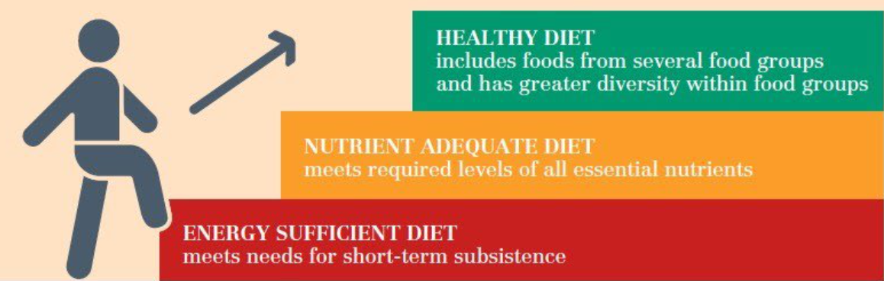
Levels of diet quality
Source: Herforth et a. 2020 from “Food Affordability - The role of the food industry in providing affordable, nutritious foods to support healthy and sustainable diets” downloaded from https://www.wbcsd.org/contentwbc/download/14604/208448/1
Notes:
Now that we discussed why diets are not affordable, let us discuss healthy diets. To understand healthy diets, let us understand the concept of diet quality. When you eat foods that can only provide calories and less of other nutrients, this is called energy-sufficient diet and this is often on short-term only. But if you eat other foods that satisfy your requirements for both calories and nutrients, this is called a nutrient adequate diet. But if you eat food from different food groups and within each food group, you consume diverse sources and it is able to meet your nutrient requirements and offer long-term health. This means you are consuming healthy diets. We discussed previously that the quality of a diet is affected by its affordability.

Slide 13
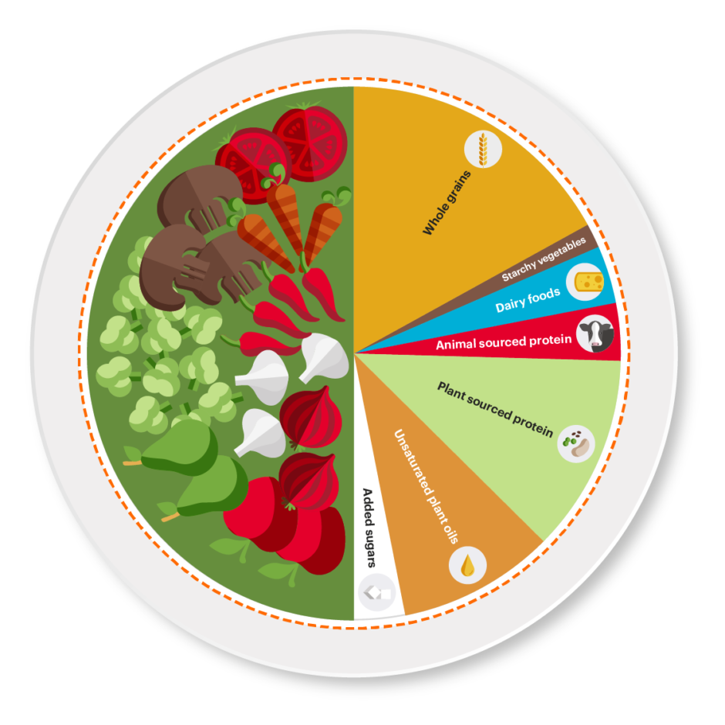
Sustainable Healthy diets
Inclusion of plant-based foods in daily consumption (including vegetables, fruits, whole grains, legumes and nuts) and decrease in consumption of red meat, sugar and refined grains to nurture health and supports environmental sustainability to reduce production of greenhouse gases that contributes to the global climate change problem
Notes:
Beyond having healthy diets, the goal is to have sustainable healthy diets. A planetary diet leans on plant-based foods and less of animal meats. Producing these foods from farm to table should have minimal green house gas emissions and reduced carbon foot print.

Slide 14


Breastfeeding, complementary feeding for infants/young children
Unprocessed, balanced across food groups
Water as fluid of choice
Safe
Preserves biodiversity
Reduces food loss and waste
Less use of plastics in packaging
Culturally-acceptable and desirable
Highly processed foods and drinks
High in sugar, sodium, saturated fats and contain trans-fatty acids that increase risk to disease
Cause food-borne diseases
Antibiotics and hormones in food production
High greenhouse gas emissions, chemical pollutants
Results to overfishing and overhunting
Adverse gender-related impact
Notes:
The WHO and FAO identied guidelines for sustainable healthy diets. The check marks include making sure to breastfeed and give appropriate complementary feeding to infants and young children to start them on healthy diet. Consume whole foods and water should be the fluid of choice. Food should be safe, preserves biodiversity, reduces food loss and waste, limits the use of plastics. Diets must also be culturally acceptable and desirable. On the other hand, the don’t’s include consuming highly processed foods and drinks, foods high in sugar, sodium, saturated fats and TFA. It should not cause food-borne diseases. It limits the use of antibiotics and hormones in production. Limit greenhouse gas emissions. It should not result to overfishing or hunting and there should be no adverse gender related impact.

Slide 15
Filipinos are not consuming healthy diets
2% or 5.3 million are severely food insecure
33.4% or 42 million are moderately food insecure
60 % of infants under 6 months are exclusively breastfeeding
13.3% of children 6-23 months meet the minimum acceptable diet
9 out of every 10 Filipinos do not meet their energy requirements
Notes:
Considering the factors earlier mentioned, it is not surprising that Filipinos are not consuming healthy diets. Abour 47 million Filipinos have severe or moderate food insecurity. Infants too don’t receive healthy diets especially complementary feeding is way way too poor. 9 out of every 10 Filipinos do not even meet their energy requirements.

Slide 16
Filipinos can’t afford a healthy diet
68.6% or about 75.2 million cannot afford a healthy diet in 2020
Cost of a healthy diet in 2020: Php243.5 per person per day
A household of five members will need Php1,212 per day to consume healthy meals in a day
PSA estimates that a family of five needs Php400 per day to meet their basic food and non-food needs
Minimum wage in Metro Manila is Php570 in 2022
Year | In Pesos
2017 | 226.60
2018 | 236.04
2019 | 238.90
2020 | 242.3
Source: FAO
Notes:
The reality is that Filipinos cant afford a healthy diet or about 75 million Filipinos. The cost of a healthy diet in 2020 was estimated at Php243 pesos per person per day. Thus, a household with 5 members will need Php 1,212 everyday. On the other hand the Philippine Statistics Authority estimated that a family of five needs Php400 per day for basic needs. The estimates of PSA are referred to when determining the minimum wage which is currently about Php570 in Metro Manila. The increase in cost of healthy diets are not at par with the increase in wages.

Slide 17
Percentage of households unable to afford nutritious diet
Energy-only diet (Php108)
Nutritious diet (Php206)
Source: Fill the Nutrient Gap Philippine Summary Report, WFP/DOST-FNRI/UNICEF (2018)
Notes:
In a modelling study in 2018 showed that 97 percent of households would not be able to afford an energy-only diet which was equivalent to Php108 pesos at that time for a family of five in a day. On the other hand, in terms of quality, the average cost for the nutritious diet was PHP 206. One third of households would not be able to afford a nutritious diet. Based on the analysis done, there is a strong correlation between stunting prevalence and the non-affordability of a nutritious diet by region. This suggests that economic access to nutritious food is a barrier to providing a nutritious diet to young children.
The research study also assess capacity of 4Ps beneficiaries to avail an energy-only diet. Based on the analysis, the nationwide conditional cash transfer social safety net which provides households with a maximum of PHP 1,400 per month provides less than one third of the cost of an energy-only diet for the modelled five person household.
Source: Fill the Nutrient Gap Philippine Summary Report, WFP/DOST-FNRI/UNICEF (2018)

Slide 18
Not consuming healthy diets results to
Increased risk of obesity, heart disease, diabetes, cancer
Stress, tiredness, reduced capacity to work (short-term)
Undernutrition including stunting, wasting,
Micronutrient deficiencies or excess
Increased risk of dying and disability- adjusted life years (DALYs)*
Violation of the human right to adequate food
Not meet Sustainable Development Goals particularly Goal 2 on ending hunger and all forms of malnutrition
* DALYs for a disease or health condition are the sum of the years of life lost to due to premature mortality (YLLs) and the years lived with a disability (YLDs) due to prevalent cases of the disease or health condition in a population (WHO).
Notes:
Not consuming healthy diets would have consequence on individual health and quality of life. The right of each person to have adequate food is not fulfilled. It leads to human deprivation which makes it hard for the country to achieve the Sustainable Development Goal particularly on ending hunger.

Slide 19
Some actions to support affordable healthy diets
Laws
First 1000 Days Law (RA 11148)
Policies
Policy on TFA elimination
Plans/
Programs
PPAN
4Ps
PDP
Tax on Sweetened beverages
Healthy Food Options in Schools (DepED Order 13 S. 2017
Kadiwa ni Ani
Dietary Supplementation
Nutrition Labelling
Health Promotion Strategy
Food fortification
Salt iodization
Urban gardening
Notes:
There have been quite a number of interventions to support affordable healthy diets. Of note is the current Philippine Development Plan which includes targets for reducing food inflation and ensuring food security and nutrition through production and effective supply management.

Slide 20

Notes:
The new Philippine Plan of Action for Nutrition or PPAN for 2023-2028 provides the directions to reduce hunger and malnutrition. Interventions to promote healthier diets, better practices and improved access to quality nutrition and related services are to increase availability, accessibility and affordability of nutritious foods, social and behavior change communication and delivery of integrated programs on nutrition.

Slide 21
Recommended actions for sustainable healthy diets
Address inequities and inequalities and consider the perspective of people who experience poverty and deprivation
Promote capacity development strategies for behavior change, including consumer empowerment and effective food and nutrition education
Quantify and balance the potential trade-offs to make sustainable healthy diets available, accessible, affordable, safe, and appealing for all
Develop national food-based dietary guidelines that define context-specific sustainable healthy diets by considering the social, cultural, economic, ecological, and environmental circumstances
Notes:
WHO and FAO recommends these actions to enable sustainable healthy diets to become available, accessible, affordable, safe and desirable. It requires addressing inequities and inequalities, support consumer empowerment and nutrition education for behavior changes, careful balance of potential tradeoffs and having national food-based dietary guidelines considering country contexts.

Slide 22
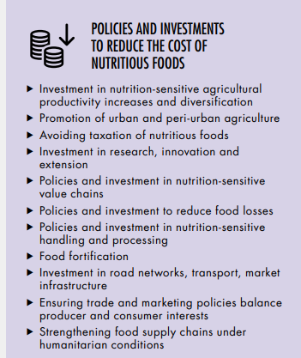
Policy actions for Food System transformation
Notes:
The State of Food Security and Nutrition in the World 2022 Report identified policy actions and investments to be considered to transform food systems worldwide towards greater affordability of healthy diets. These include policies to reduce the cost of nutritious food such as investment in nutrition-sensitive agricultural productivity and diversity, urban agriculture, no taxes for nutritious foods, reduction of food losses, food fortification and strengthening food supply chains.

Slide 23
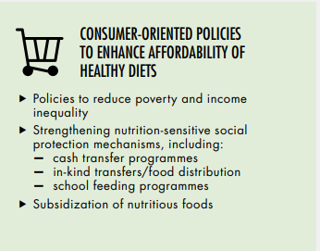
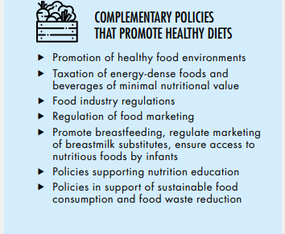
Policy actions for Food System transformation
Notes:
Consumer-oriented policies that enhance affordability of healthy diets along reduction of poverty and income inequality, nutrition-sensitive social protection mechanism and subsidies for nutritious foods. There should also be complementary policies that promote healthy diets by promoting healthy food environments, taxation of foods with low nutritional value, food regulation, marketing regulation, promoting breastfeeding ang implementing the Milk Code and increased access of nutritious foods to infants, nutrition education and towards sustainable food consumption and food waste reduction.

Slide 24
Practical Ways to Consume Healthier Diets
Create a meal plan and refer to the Pinggang Pinoy.
Cook meals at home instead of eating outside the home.
Incorporate fruits, vegetables, legumes and nuts in daily meals. Choose green leafy vegetables that are relatively inexpensive and rich in protein.
Avoid buying highly processed foods and instead buy whole foods.
Replace meat with other proteins such as legumes, eggs, small fishes and canned fish.
Grow own foods at home or in communities.
Notes:
At the individual or family level, here are some practical ways to consume healthier diets:
Create a meal plan to stick to a budget and reduce food waste. Refer to the Pinggang Pinoy on having the right food group proportions on a per-meal basis.
Cook meals at home instead of eating outside the home. Meals bought outside the home tend to be more expensive.
Incorporate fruits, vegetables, legumes and nuts in daily meals. Fruits bought in season are relatively less expensive. There are many vegetables that are packed in nutrients but not heavy on the wallet. Choose green leafy vegetables such as kangkong, malunggay, alugbati, camote tops, mustasa, saluyot, talinum, and non-leafy vegetables such as sigarilyas, sitaw (long beans) and okra. Legumes such as kadyos (pigeon pea), patani (lima beans) are relatively inexpensive and rich in protein.
4. Avoid buying highly processed foods and instead buy whole foods.
5. Replace meat with other proteins such as legumes, eggs, small fishes and canned fish.
6. Grow own foods at home or in communities. Having food gardens not only provide additional source of food but also potential income and physical activity.

Slide 25
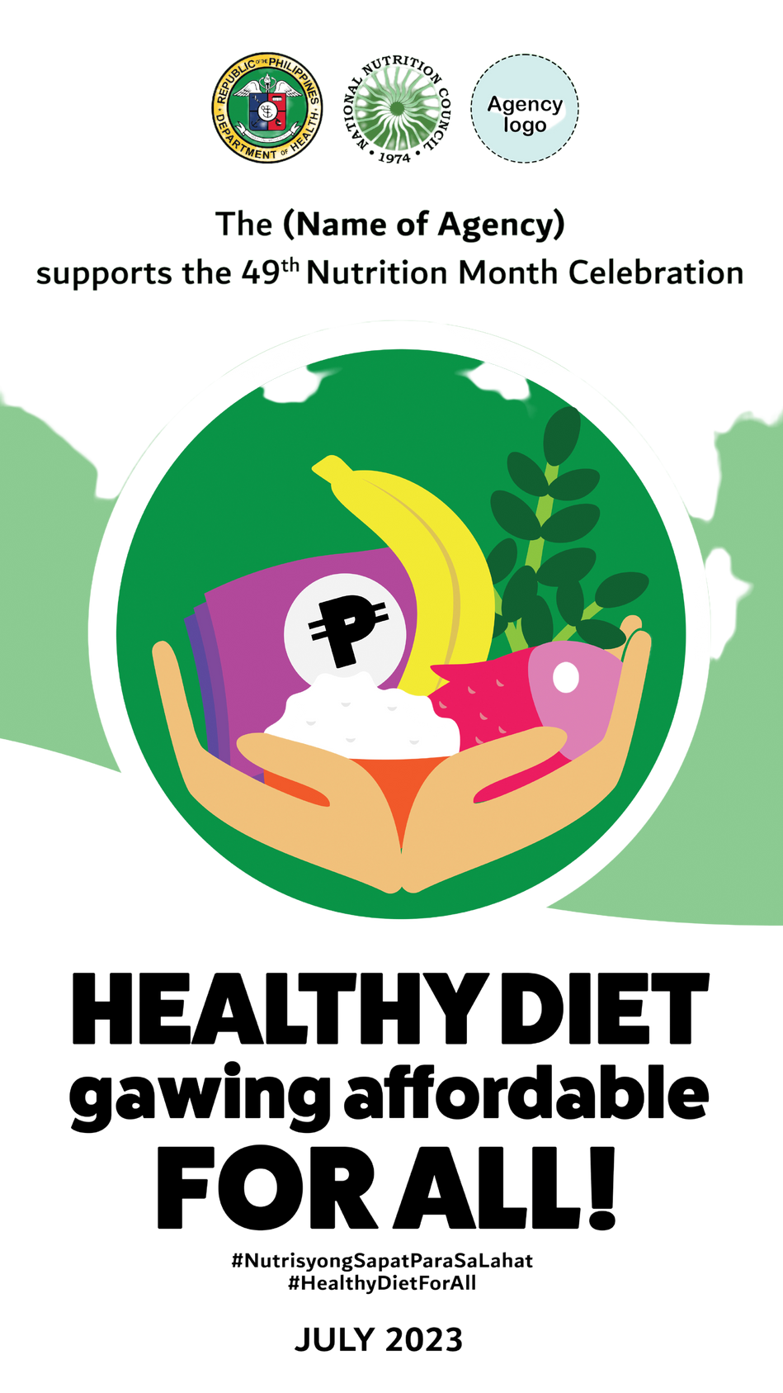
2023 Nutrition Month Objectives
Engage consumers to support improvements in levels of diet quality towards sustainable healthy diets;
Generate participation of stakeholders at various levels on actions towards enabling access to affordable sustainable healthy diets; and,
Call support for the Philippine Plan of Action for Nutrition 2023-2028 as the framework for action to improve nutrition security.
49 Nutrition Month
th
Notes:
Considering the challenge of Filipinos to have affordable healthy diets, the Nutrition Month campaign aims to raise awareness on supporting Filipinos improve access to affordable healthy diets to reduce malnutrition, improve food security, health and quality of life. It aims to engage consumers which means the general public to support them on how they can shift from energy-sufficient diets to sustainable healthy diets. Nutrition Month shall also encourage stakeholders especially those involved in food systems meaning from production to consumption to work towards the actions for sustainable healthy diets. Since the PPAN 2023-2028 supports food security, improved nutrition or having healthy diets, Nutrition Month will campaign for support to the PPAN.

Slide 26

Key Messages for Individuals, Families and Communities
Start children on a healthy diet with exclusive breastfeeding in the first six months and continued breastfeeding up to two years and beyond with appropriate complementary feeding.
Eat a variety of unprocessed or minimally processed foods, balanced across food groups, while restricting highly processed food and drink products.
Have family and community food gardens as an additional source of food.
Buy food from local farmers.
49 Nutrition Month
th
Notes:
The Nutrition Month campaign aims to push for the following key messages:
For individuals and families, communities
Start children on a healthy diet with exclusive breastfeeding in the first six months and continued breastfeeding up to two years and beyond with appropriate complementary feeding.
Eat a variety of unprocessed or minimally processed foods, balanced across food groups, while restricting highly processed food and drink products.
Have family and community food gardens as an additional source of food.
Buy food from local farmers.

Slide 27

Key Messages for Policy-makers
Issue legislation and policies that provide subsidies for fruits and vegetables and improve food value chains.
Reduce the availability of unhealthy food through taxation, restrictions on marketing and consumer education.
Rechannel resources to agriculture to enable access to affordable nutritious and safe food.
Implement the PPAN 2023-2028 by scaling up food and nutrition security interventions.
49 Nutrition Month
th
Notes:
For policy-makers, program managers and legislators
Issue legislation and policies that provide subsidies for fruits and vegetables and improve food value chains.
Reduce the availability of unhealthy food through taxation, restrictions on marketing and consumer education
Rechannel resources to agriculture to enable access to affordable nutritious and safe food.
Implement the PPAN 2023-2028 by scaling up food and nutrition security interventions.

Slide 28

Key Messages for Food Industry Players
Reformulate food products to reduce salt/sodium, saturated fat, free sugars
Eliminate the use of hydrogenized or partially hydrogenized oils to remove trans-fatty acids from food products
Produce healthier food products with less processing.
49 Nutrition Month
th
Notes:
For food industry
Reformulate food products to reduce salt/sodium, saturated fat, free sugars
Eliminate the use of hydrogenized or partially hydrogenized oils to remove trans-fatty acids from food products
Produce healthier food products with less processing.

Slide 29
Ways to Support Nutrition Month Campaign:
Review organization plans and budget and tweak to include nutrition-related activities and services.
Disseminate information about Nutrition Month through streamers, websites, and social media.
Participate in Nutrition Month activities of the NNC and other
agencies.
Conduct webinars and online fora for the general public recognizing the importance of healthy and affordable diet.
Provide services to address food insecurity.
Conduct Nutrition Month activities related to the theme, such as activities on how to promote healthy and affordable diet.
49 Nutrition Month
th
Notes:
And before I close, let me share suggested activities by which you or your community or organization can do during Nutrition Month. Help disseminate information about Nutrition Month in whatever channel available to you. Maximize the use of social media to help disseminate nutrition month activities. You can also participate in Nutrition Month activities of the NNC, other agencies, workplace, schools and your local government unit or community.

Slide 30
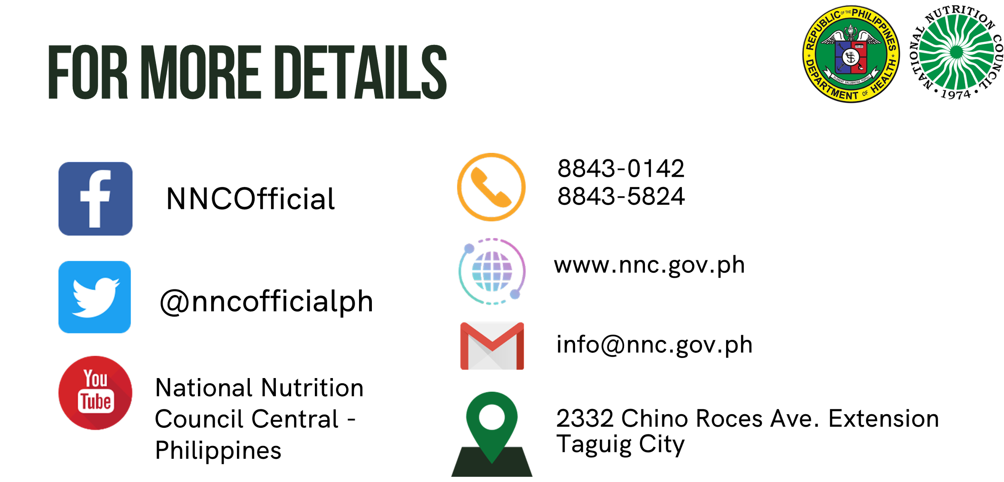
For more details:
49th Nutrition Month
th
Notes:
That’s all from the NNC. Again, thank you very much!
*End of presentation*

